Slide 1
Selective Attention in LMM
Michael Zhu

Slide 2
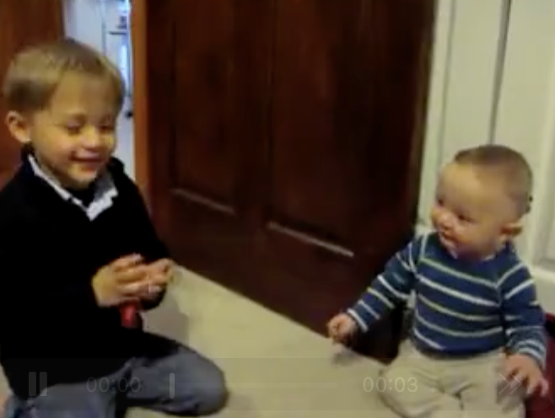
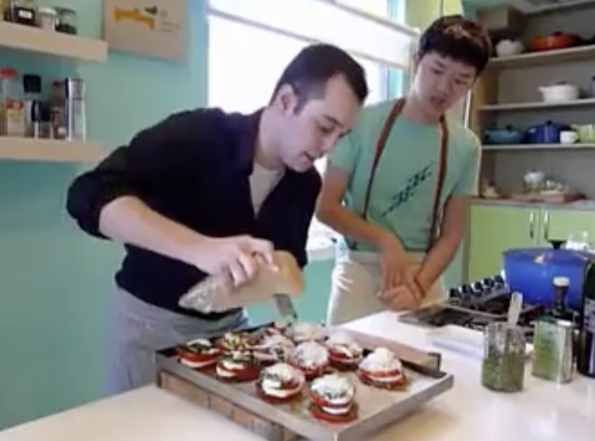
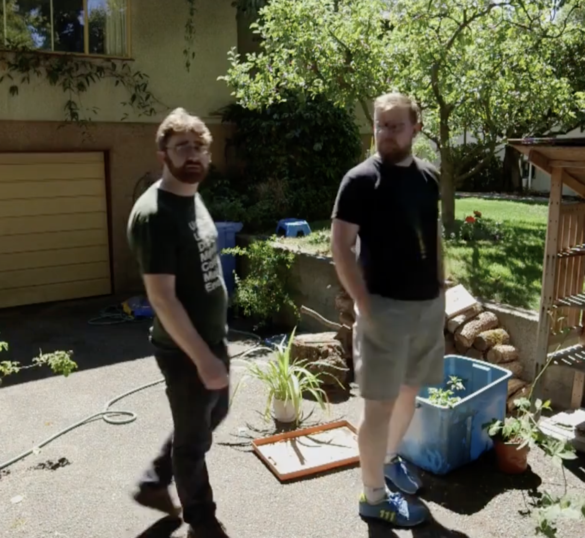
Describe the following scenes in concise language
Sibling
Cooking
Backyard
Who
What
When
Prompt for GPT : What is this scene about? answer using the most relevant word

Slide 3
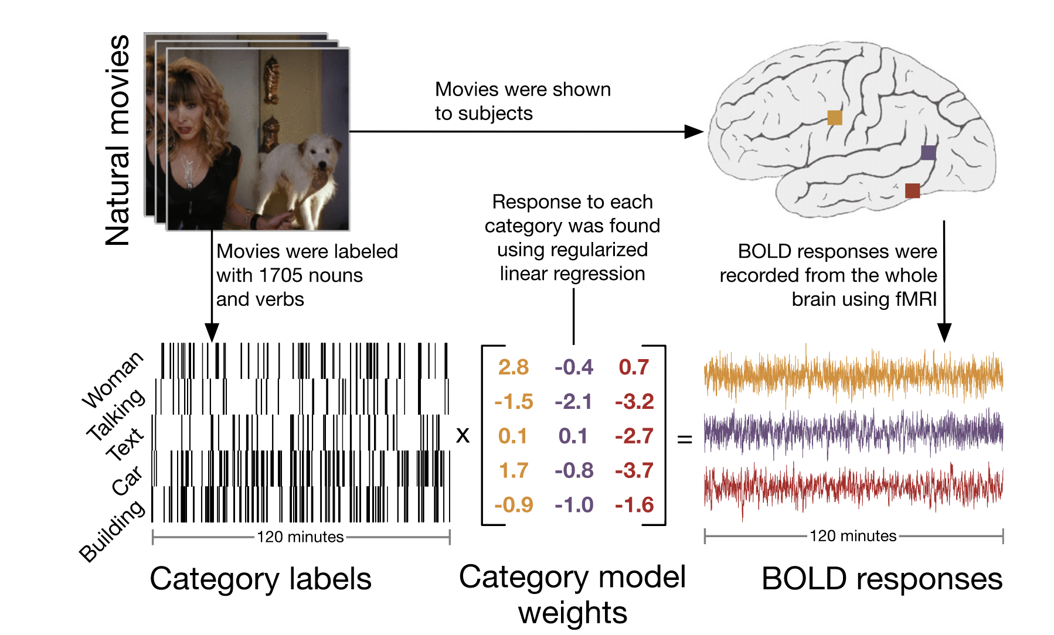
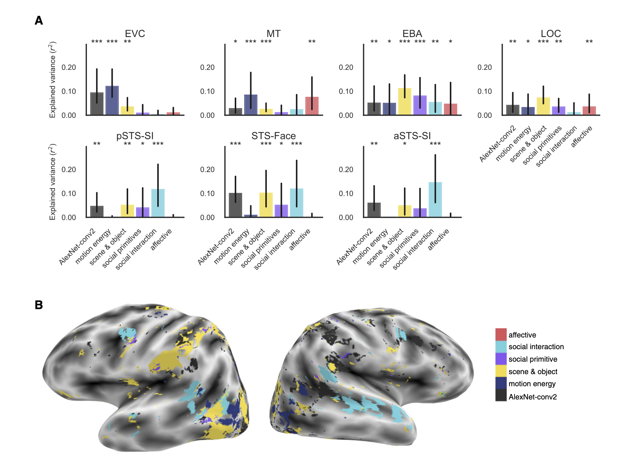
During naturalistic viewing,
We usually assume each dimension contributes consistently across all stimuli
Huth et al., 2012
McMahon et al., 2023

Slide 4
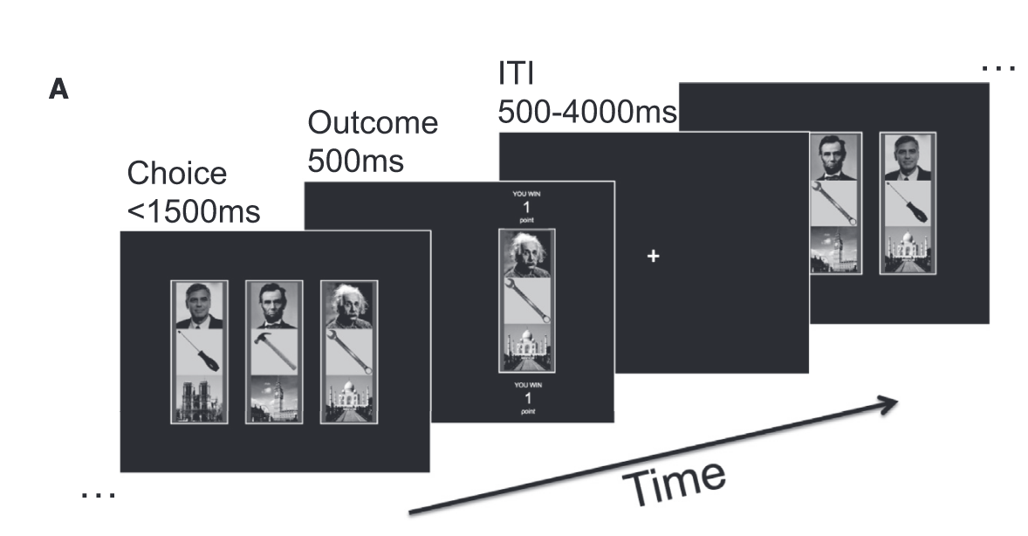
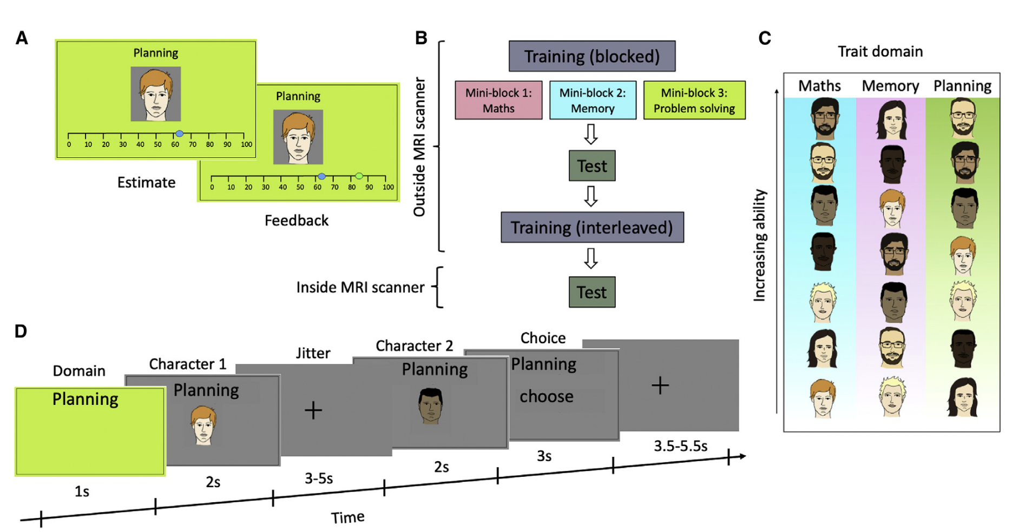
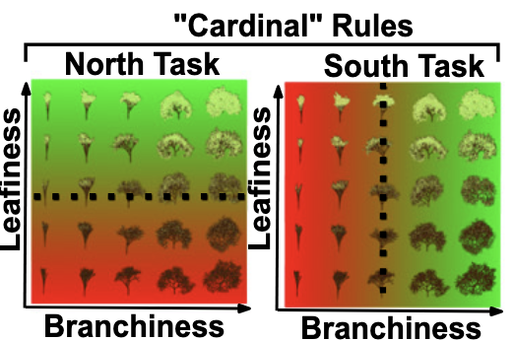
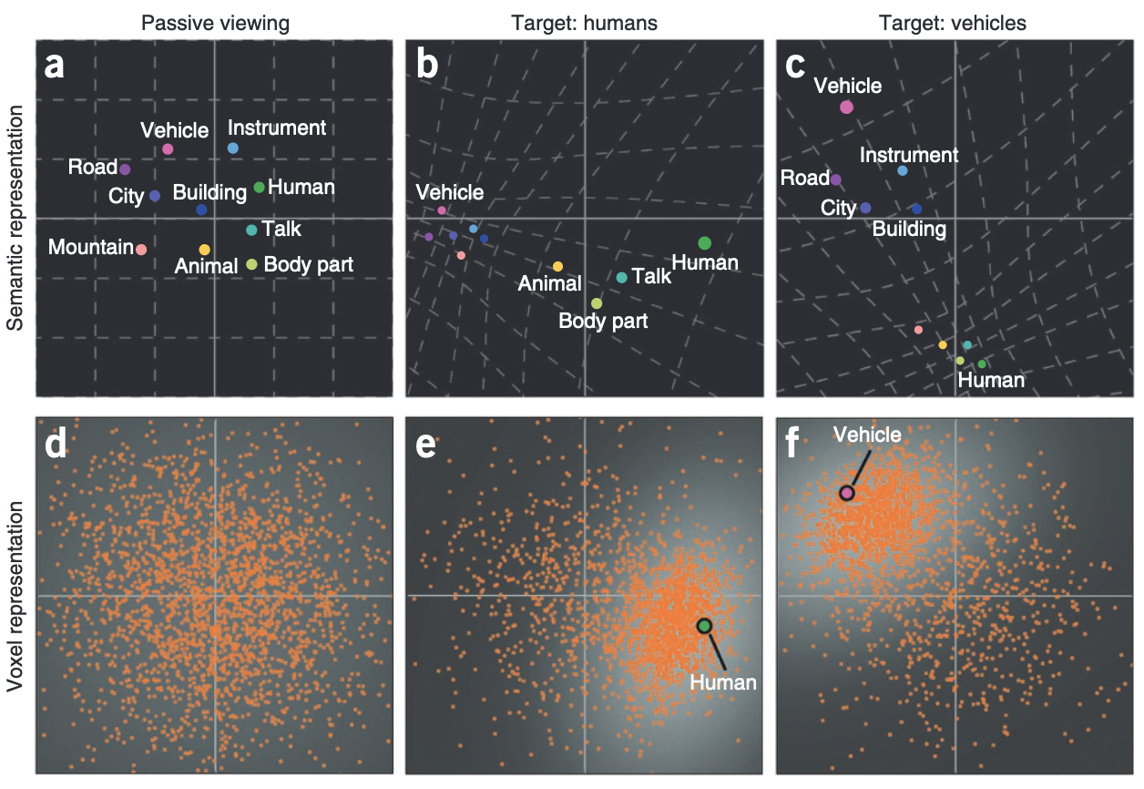
Humans flexibly attend to task-relevant dimensions when goal presented
Leong et al., 2017
Mahmoodi et al., 2023
Flesch et al., 2018
Çukur et al., 2013

Slide 5
Do humans show flexible attention allocation among dimensions during naturalistic viewing?
Who
What
When

Slide 6
Flexible attention allocation among dimensions in goal-absent setup
Stimuli is multi-dimensional
Our attention is limited, thus has to be selective
Adaptive selective attention should also be context/stimuli sensitive
Stimuli 1
Stimuli 2
Stimuli 3
Stimuli 4
Stimuli 5
Stimuli 6
Who
Where
What
What
Who
What

Slide 7
From humans to models
Preliminary feasible investigation of principles
Does the model show reliable attention allocation?
Does the model in general prioritize some dimensions over others?
Does the attentional priority shift across stimuli, and if so, can such shifts be explained by factors like novelty, uncertainty, or utility?
Under the hood, what architecture gives rise to the model's selective attention?
Do models trained on different languages—thus potentially embedded in different cultural contexts— show divergent attention tendencies?

Slide 8
Which factors count for dynamic attention during naturalistic viewing?
Novelty
Instrumental value
Perceptual Uncertainty
Reward predictability
Informativeness
Perceptual Salience
…

Slide 9
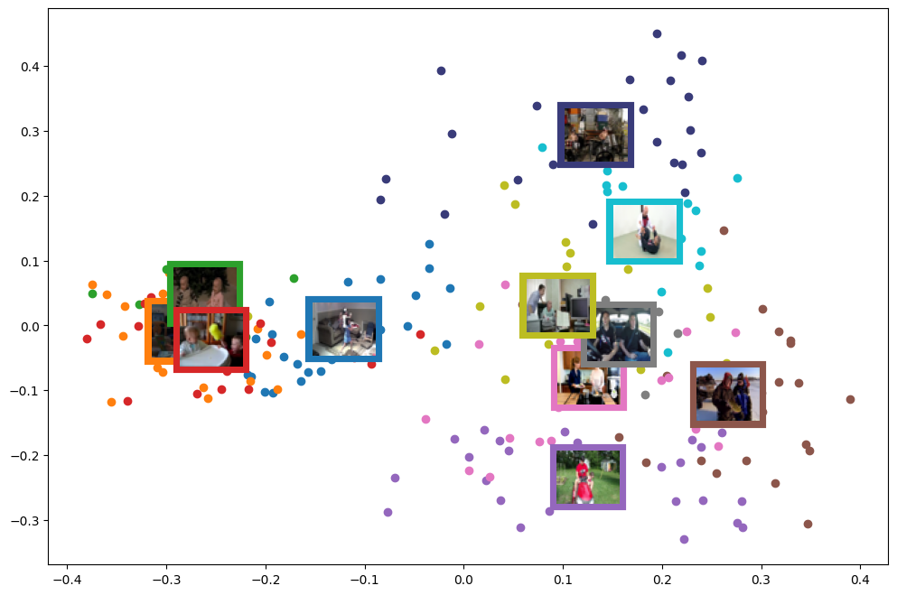
CLIP embedding clustering
Activity
Character
Location

Slide 10
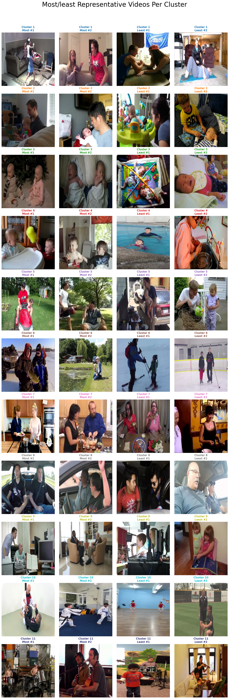
CLIP embedding clustering
location
activity
activity
character
location
character
activity
character
activity
location
activity
Notes:
Not optimal

Slide 11
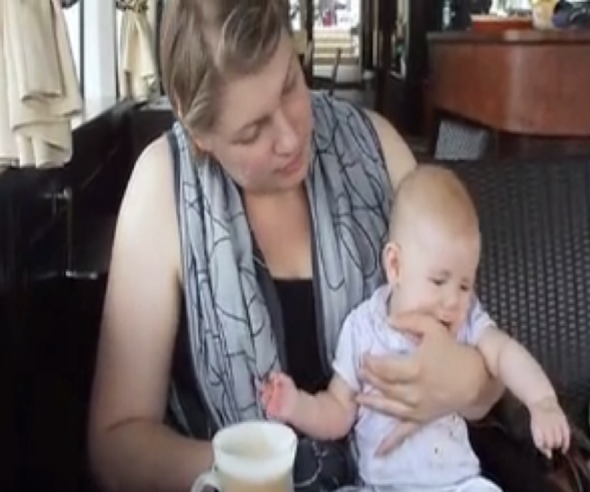
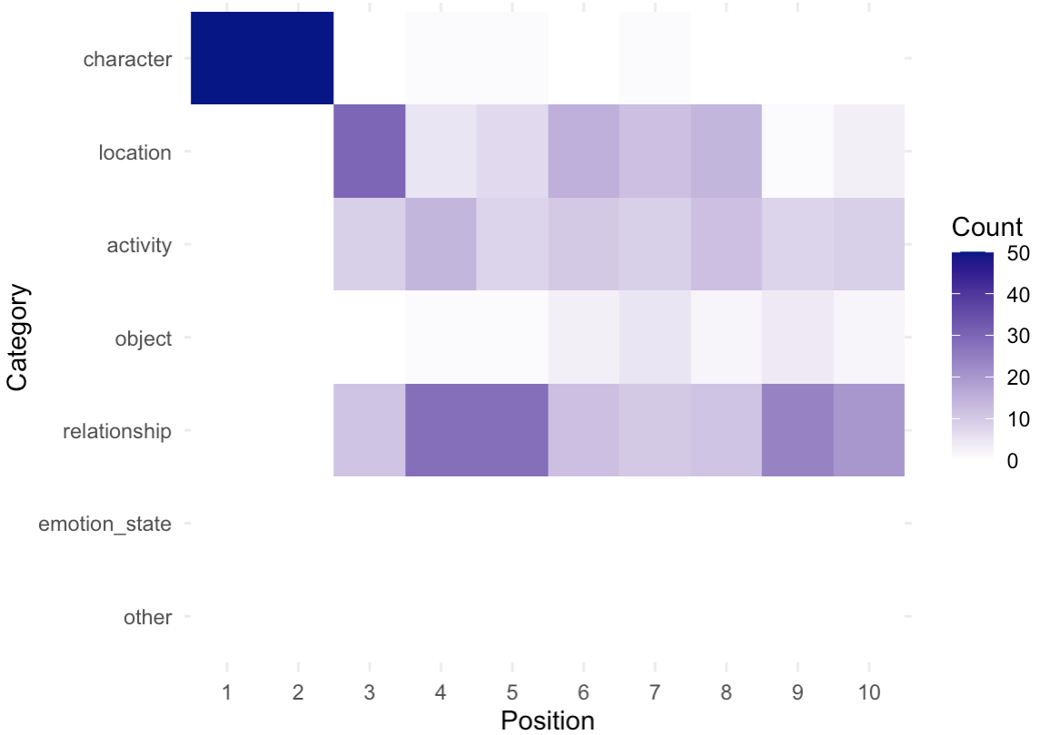
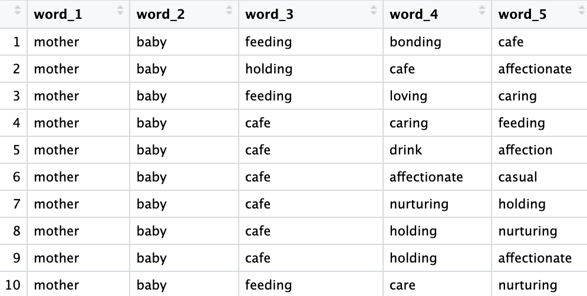
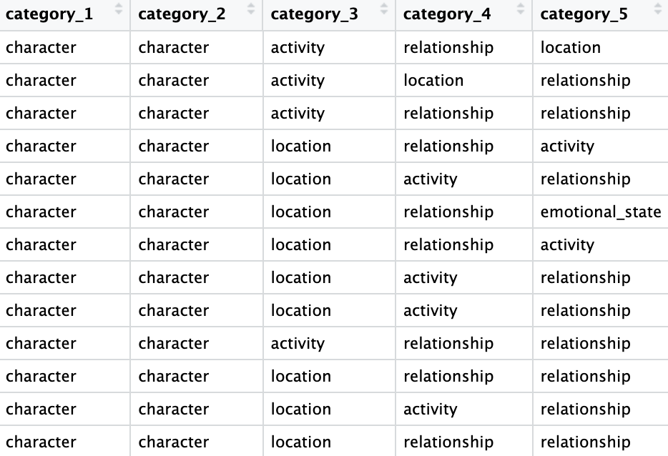
GPT Free-association
Model free-association
Dimension Identification
List 5 words that best describe this scene
(repeat 10 times)
Classify words into dimensions

Slide 12
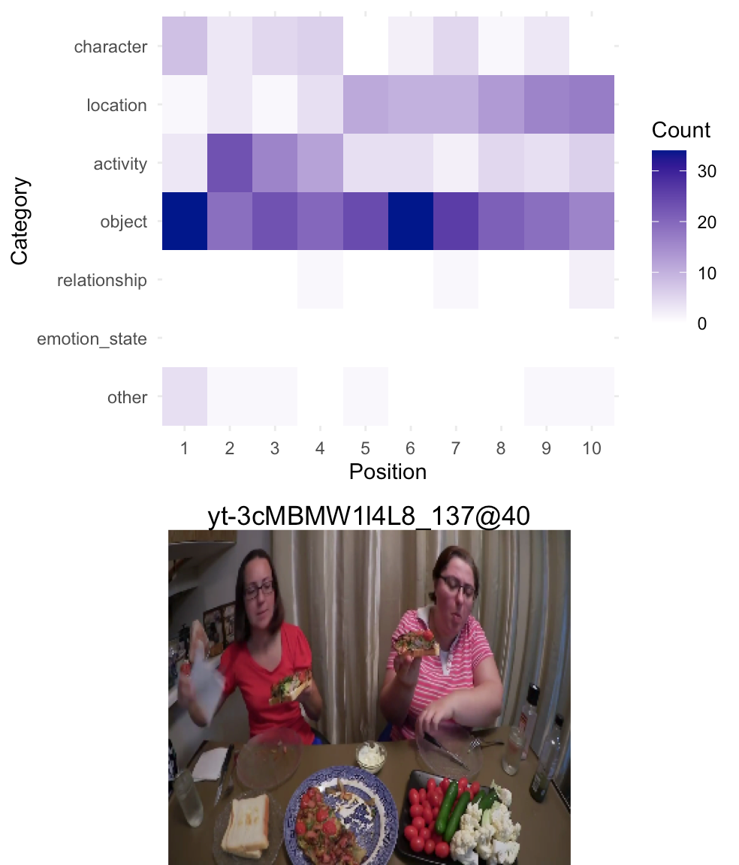
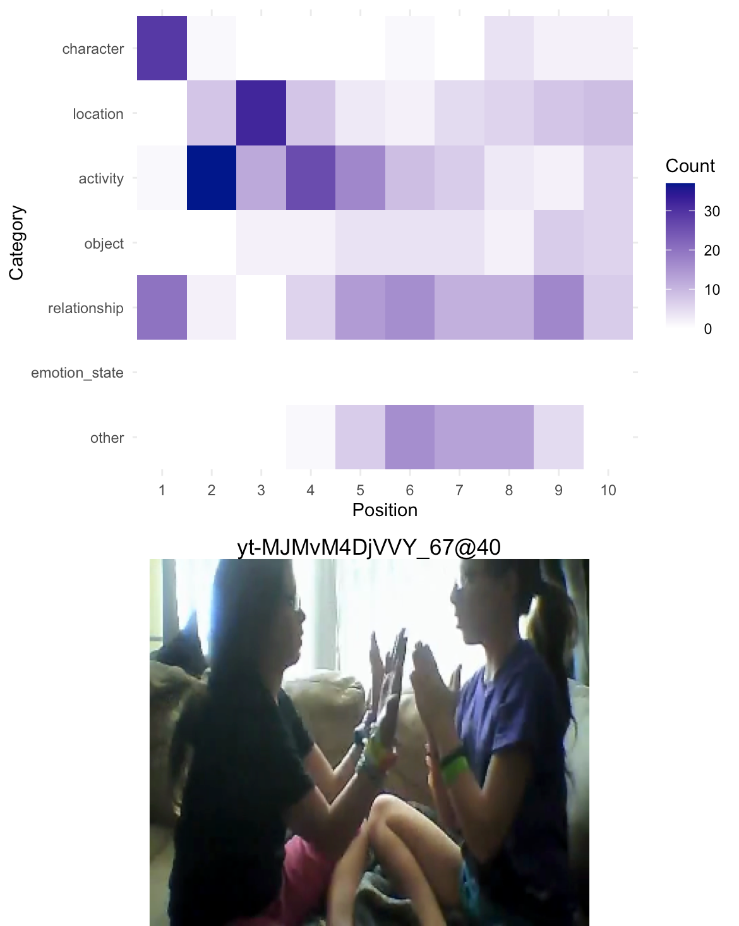
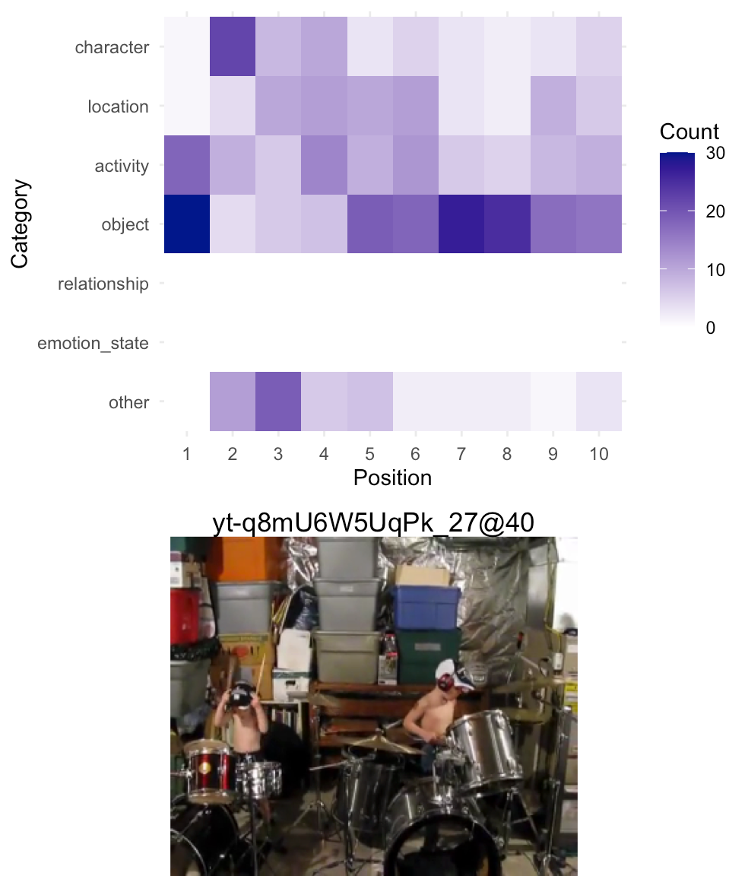
GPT Free-association

Slide 13
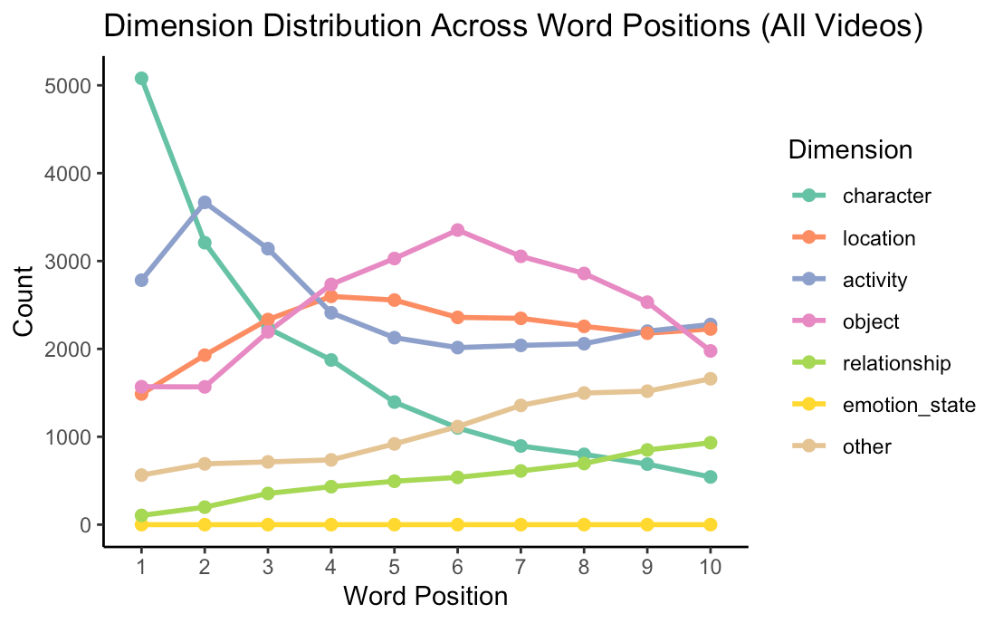
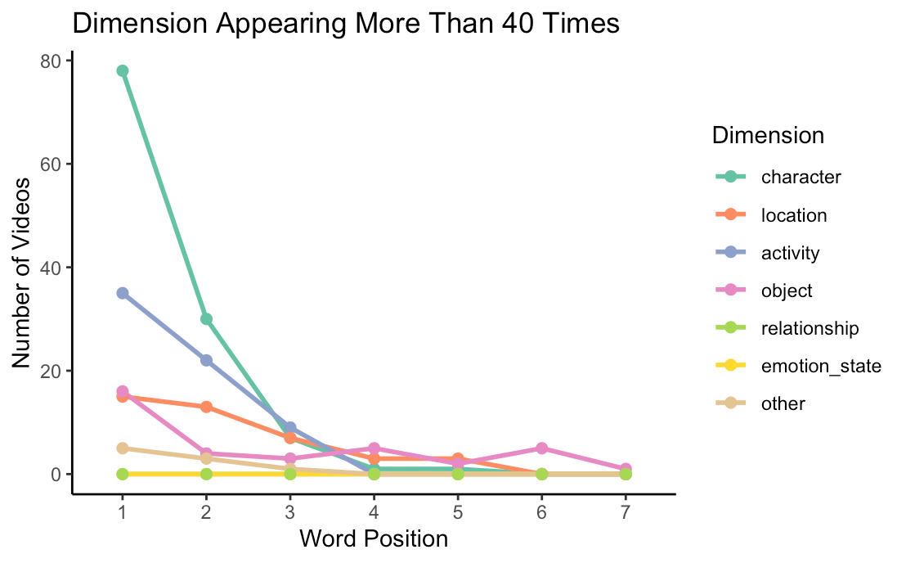
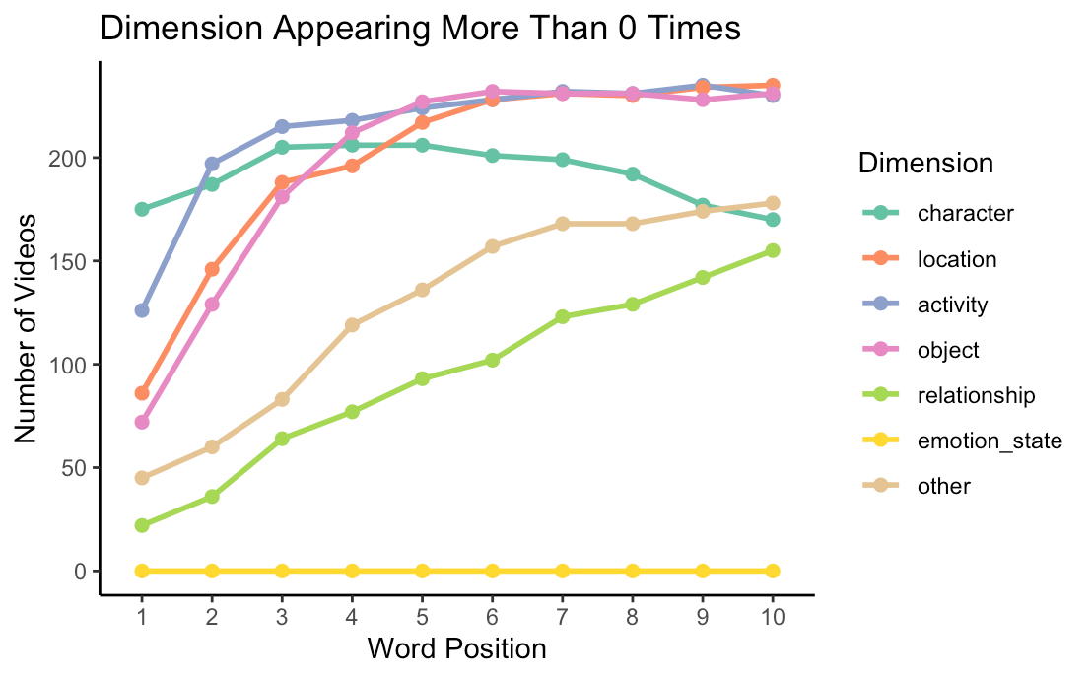

Slide 14
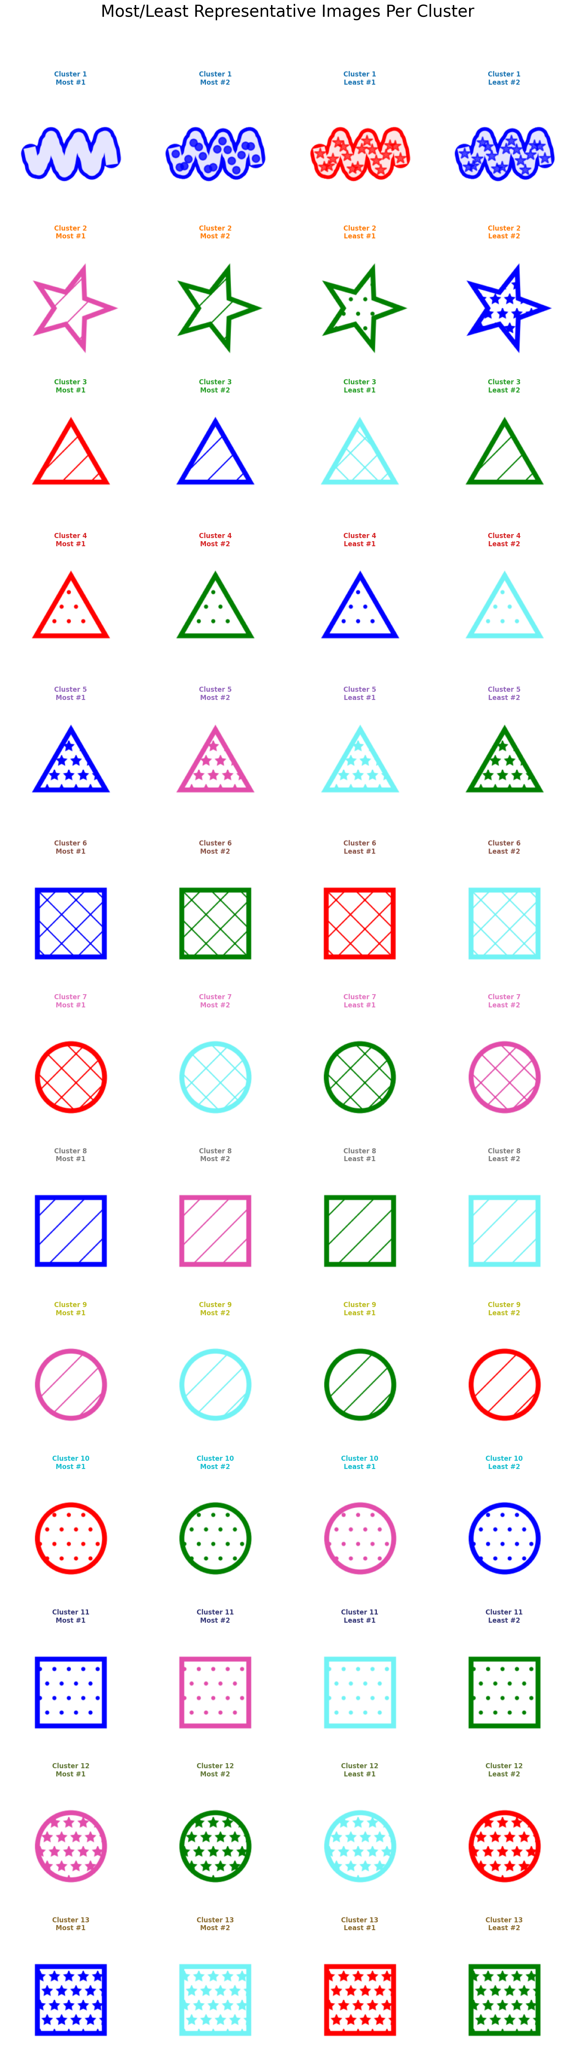
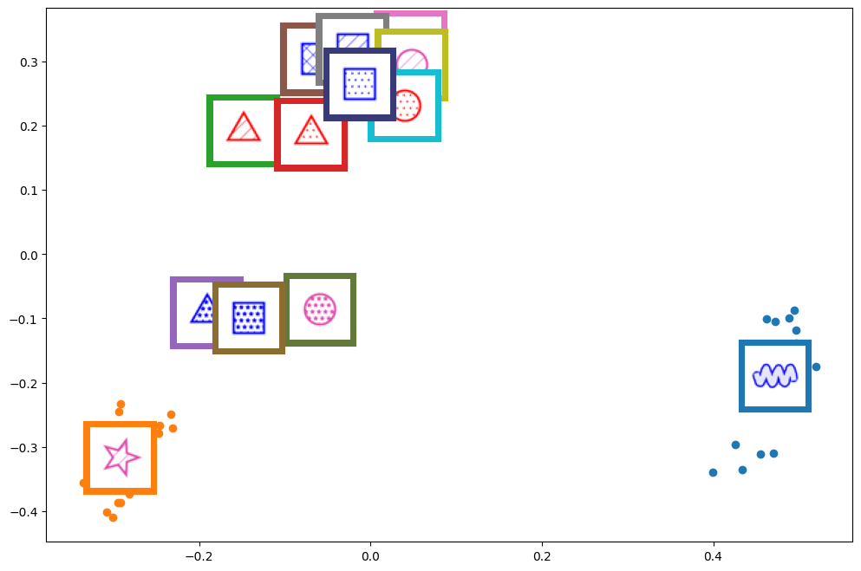
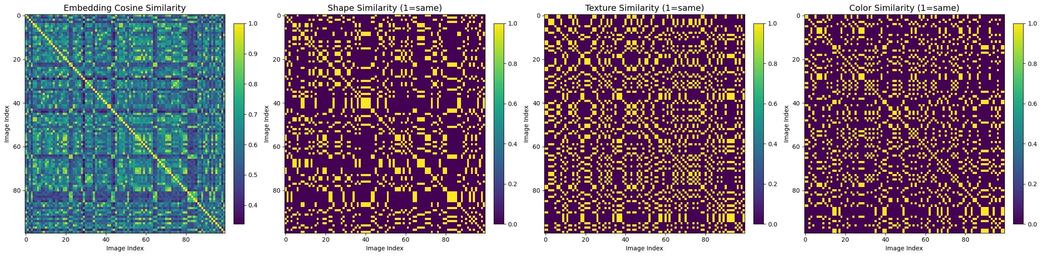
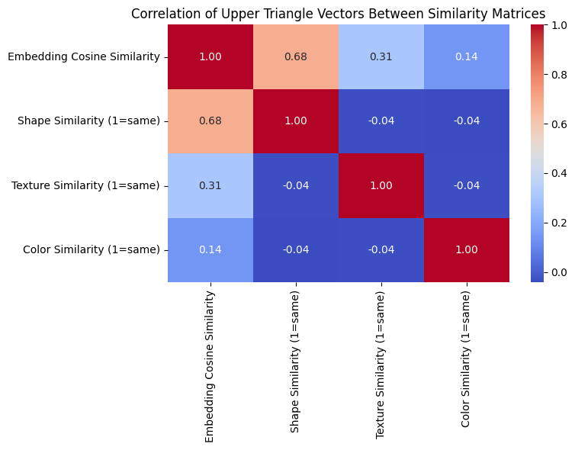
Experiment
Shape only
Shape + texture

Slide 15
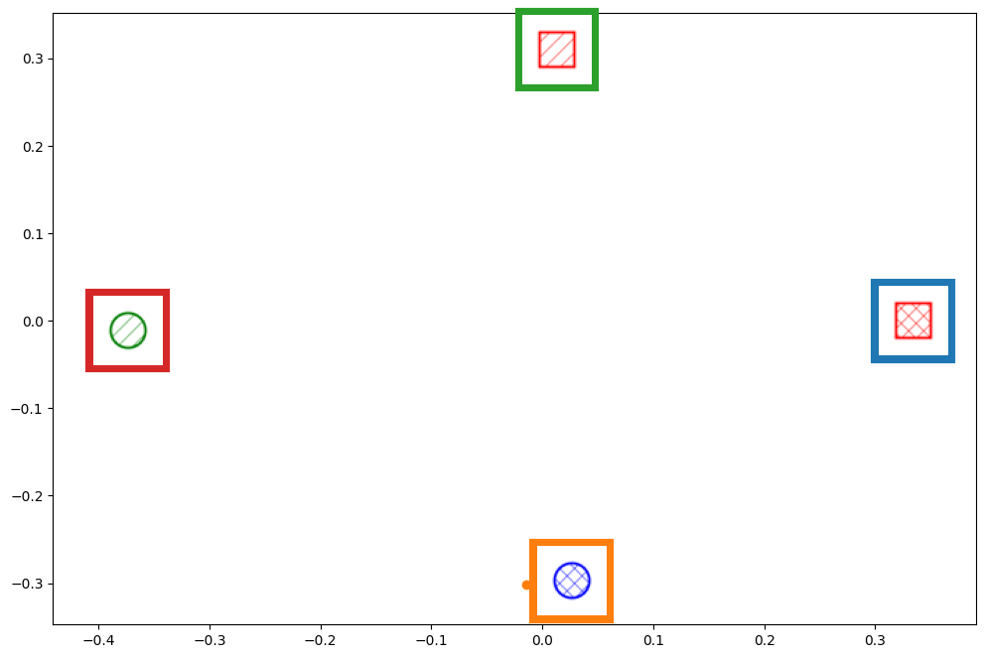
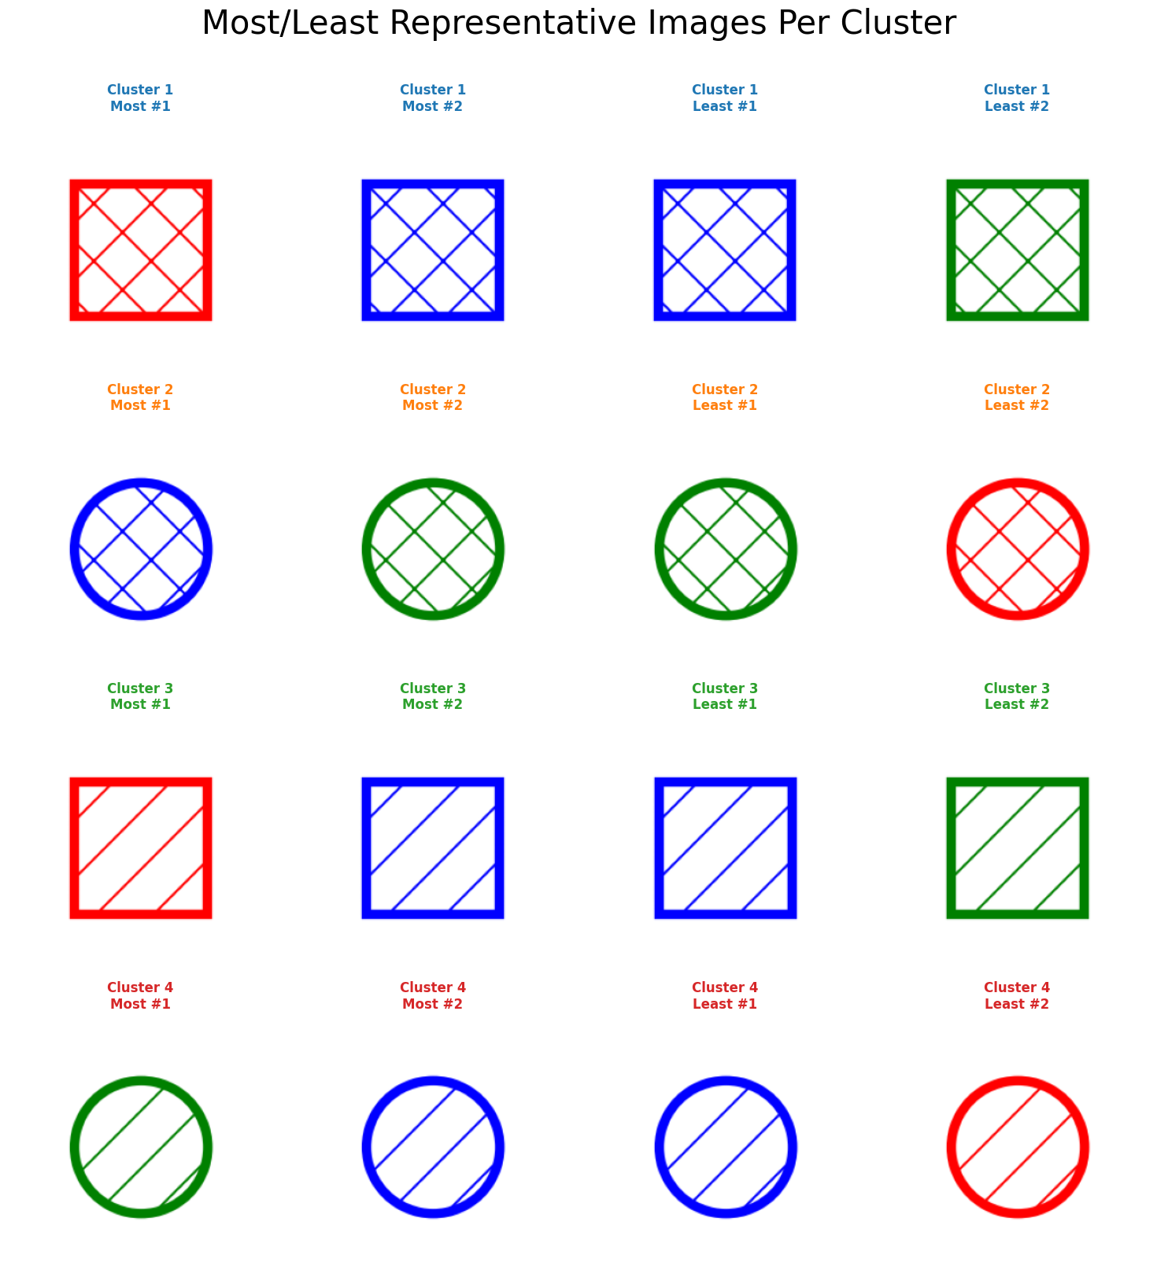
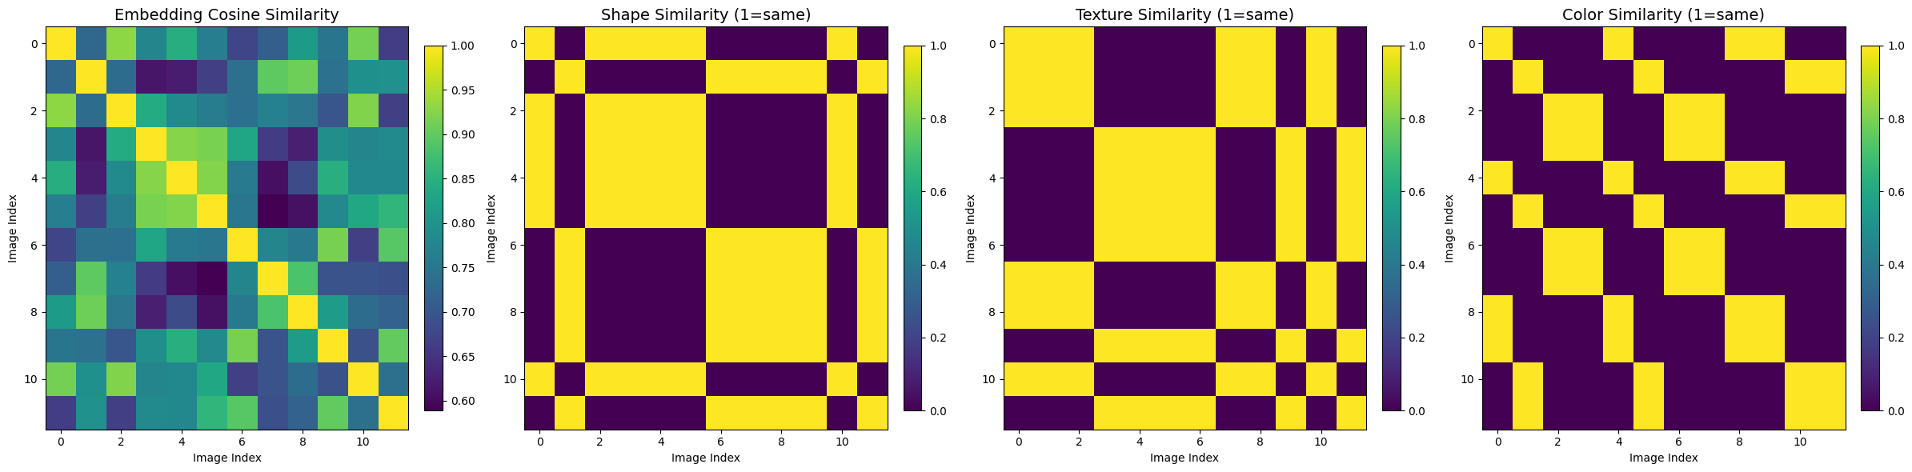
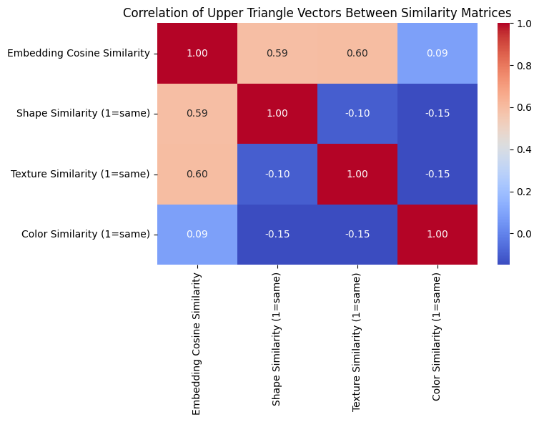
Experiment
Shape + texture

Slide 16
Experiment
With weird shapes
Without weird shape

Slide 17
More dimensions annotation

Slide 18
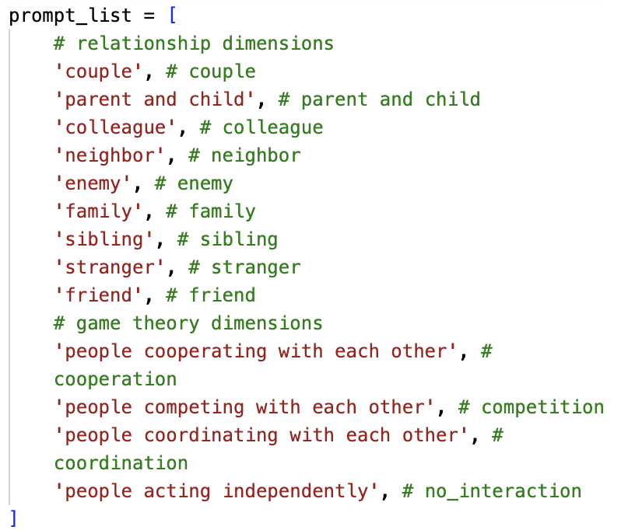
CLIP('openclip', 'ViT-H-14-378-quickgelu', 'dfn5b')
“This is a picture of ”^{[1]} +
Simple cosine similarity between video embedding and prompt embedding
[1] https://github.com/openai/CLIP?tab=readme-ov-file

Slide 19
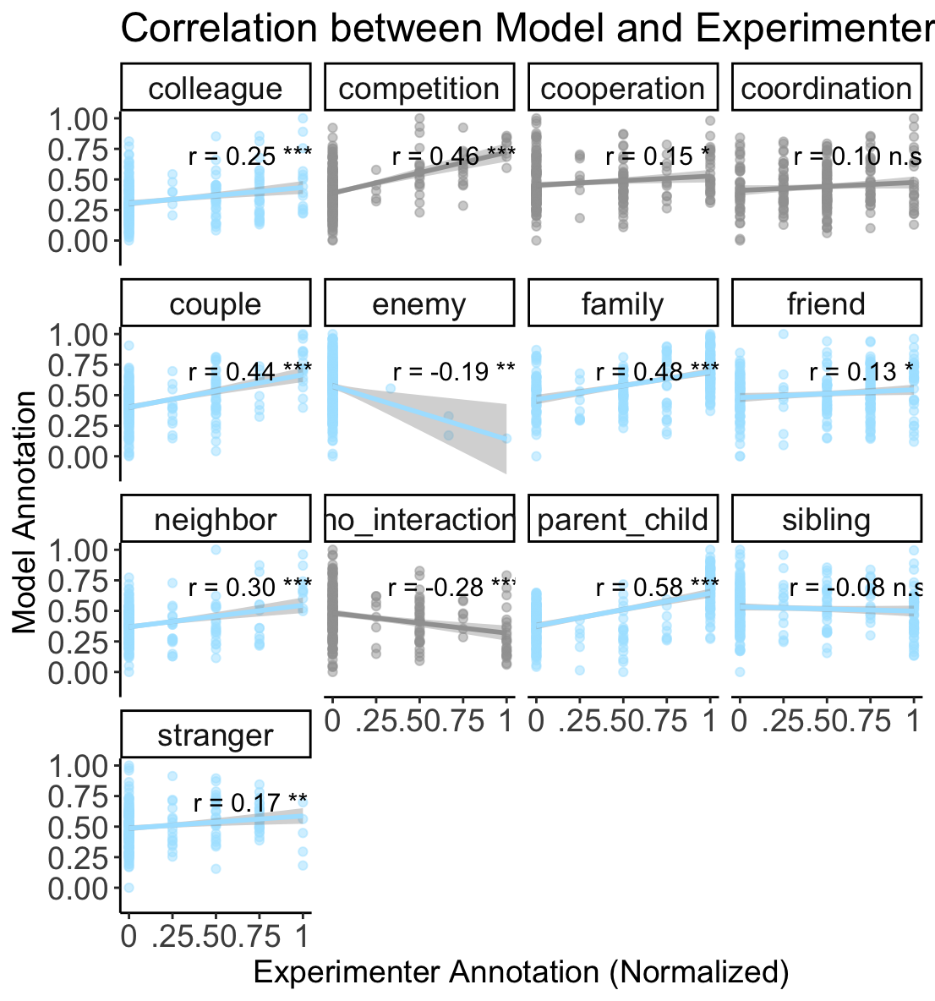
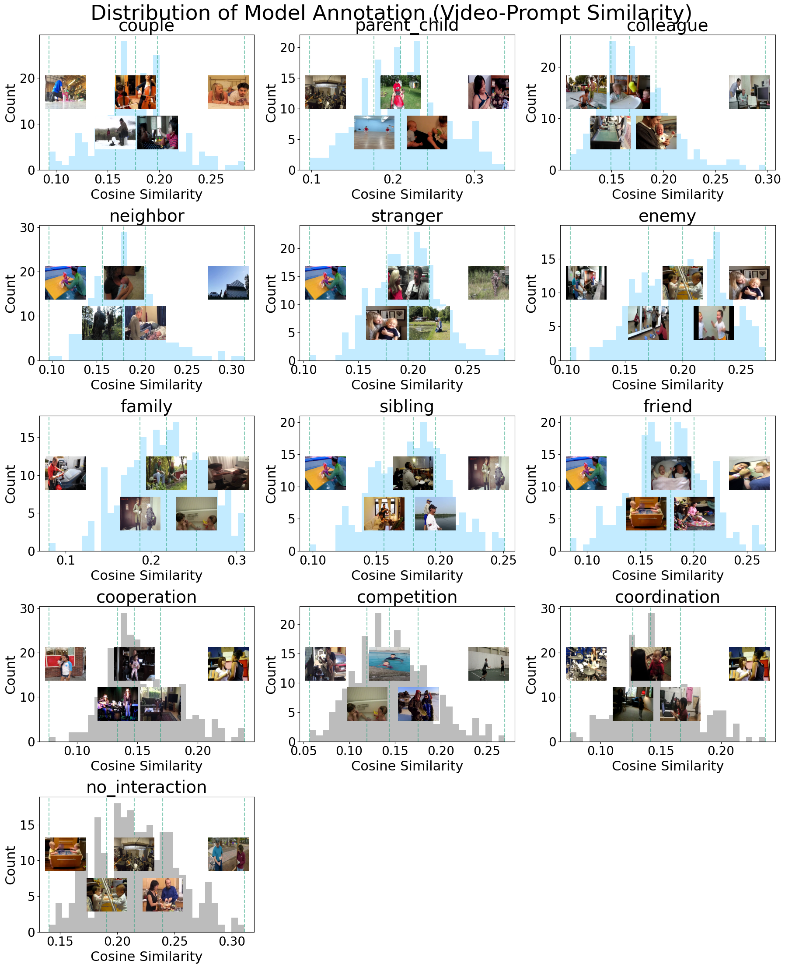
Notes:
Age, gender, location
GPT might be a better choice

Slide 20
Classic view: (Idea of RSA)
Within each dimension, similar features lead to similar responses (embedding or neural or behavior)
If one dimension is important, the final pattern is similar to that dimension
Therefore, feature similarity predicts response similarity [Theorem 1]
Response encodes one dimension
New account: flexible competing importance; boundary factor
Dimension importance is flexible.
“feature similarity predicts response similarity”
stands only when the features are weird in their dimension more than other dimensions
Response encodes one dimension only when its feature is weird, relative to other features in their dimensions
Similarity RSA has considered weirdness
Weird → large difference in matrix (scaling) → high correlation/coefficient
Good or bad

Slide 21
Representation to Category (set boundary)
Emphasize, ignore
Why sometimes who, sometimes where
A universal principle behind category identification/representation
We care about category recognition
But there are so many categories along different dimensions
Which dimension do we focus, in attention and representation?
Principle: weirdness
Feature attention → dimension attention → feature weirdness
Child → who → child is weird in who

Slide 22
RSA
Dimensions compete with each other
The one with weird feature wins, gets attention (being represented)
Share feature→ similar pattern
But didn’t consider feature heterogeneity
Features are different
Animal dimension matters, but only when feature = Anteater (related to other dims)
Anteater → activate → high signal-noise ratio → up-weighted
Dog → noise → low signal-noise ratio → down-weighted
Classic
New
attention
Stimuli feature similarity
Weirdness or salience …
Stimuli feature similarity
 | 1 | 2 | 3 | 4 | 5
1
2
3
4
5
 | 1 | 2 | 3 | 4 | 5
1
2
3
4
5
 | 1 | 2 | 3 | 4 | 5
1
2
3
4
5
Animal dimension
1,2: Anteater (weird)
3,4,5: Dog (common)
All features equally considered
attended features get upweighted
No-weight network → weighted network
Dominant + Occasional attention

Slide 23
Continuous clustering easy to understand
Categorical to comparable continuous
Similarity to other features
Norm
a1, a2, a3 ….
Category also
a3
a1
Clustering of similarity as feature
How eccentric one feature is in its dimension
Larger variance in one dimension
The dimension is more important in clustering
Practical:
mask, similarity of picture
Similarity of words

Slide 24
Relative rank for features in dimensions
Mechanism
Observation
Compete and override
stimuli
Perceptual similarity
As X and / are same
When star presented, other dimensions ignored
(Niv, dimension reduction, generalization)
Star
Cross
Triangle
Square
circle
Star
dot
dash
Slash
cross
Rank
Formally
Red
Blue
Pink
Green
mint
feature
Clustering
Distance calculation (multiple dimensions)
One dominant dimension determines clusters
Which one dominant?
Weirdness
Or other factors?
Shape
Texture
Color
dimension
Different dimensions have different rank, and variance range?
Dimensions not equally distinguished (representation distortion)
General

Slide 25
Think from ML perspective
Distinguish true effects
Clustering → distance, merge naturally
Too far, become only one; sensitive to metric
PCA → all features represented
Current is because select the first xxx PCs

Slide 26
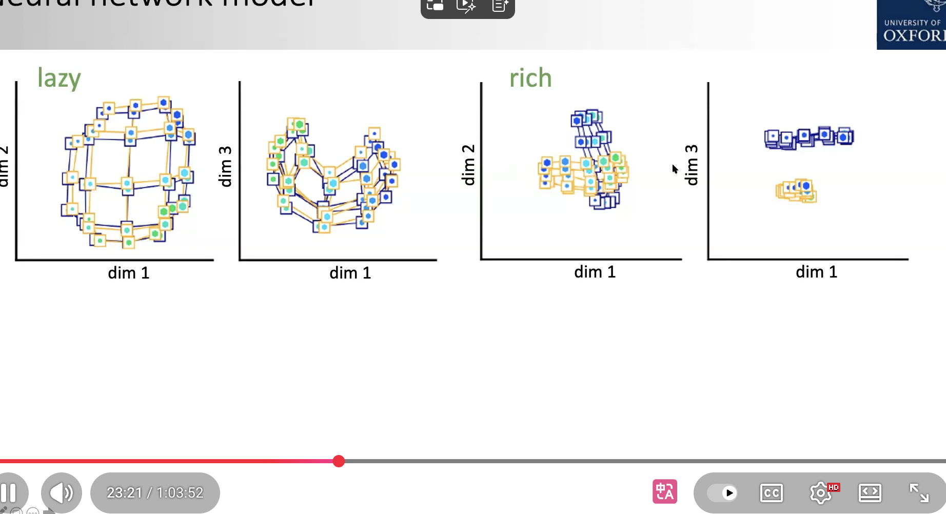
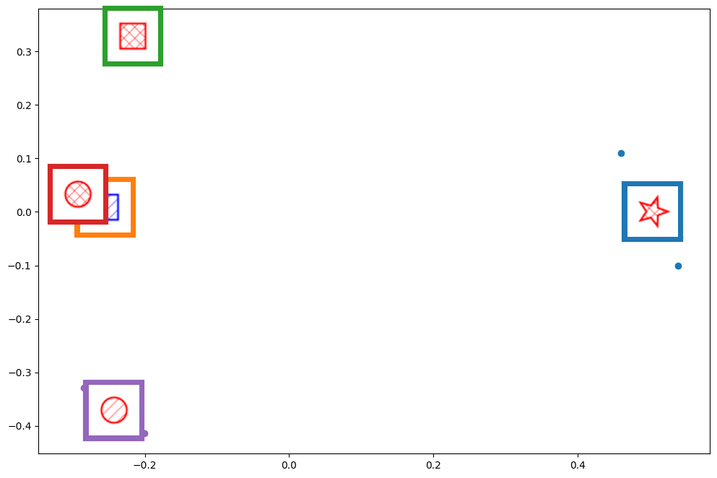
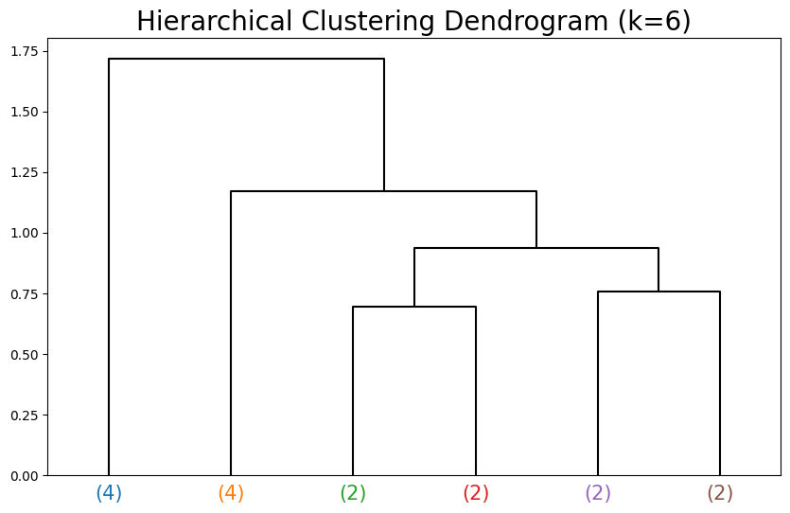
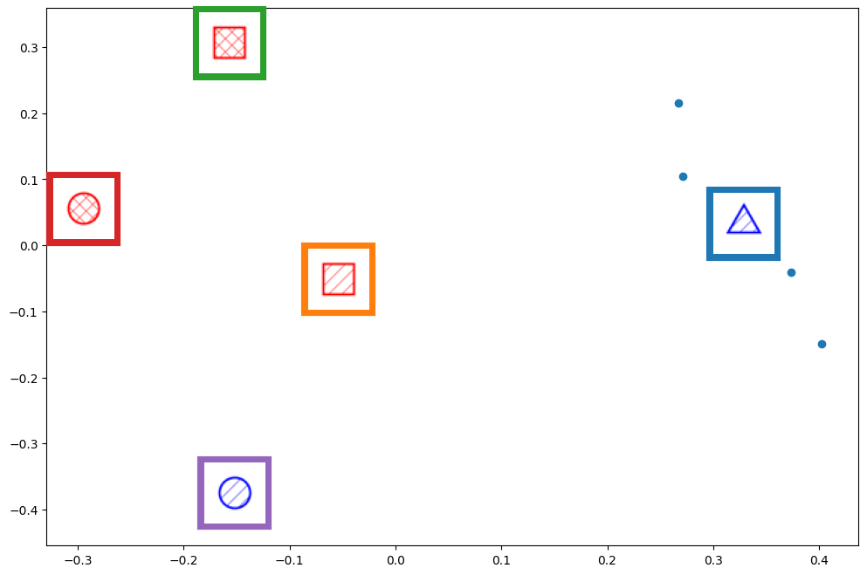
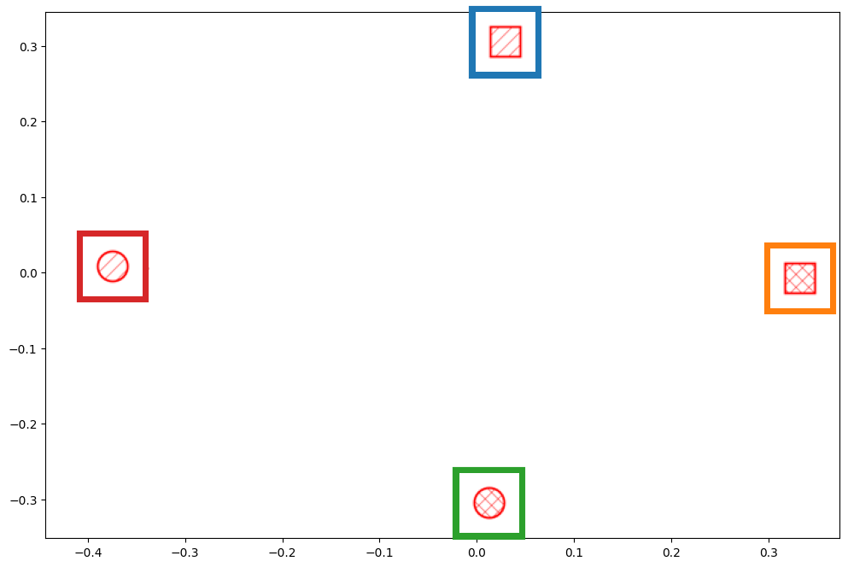
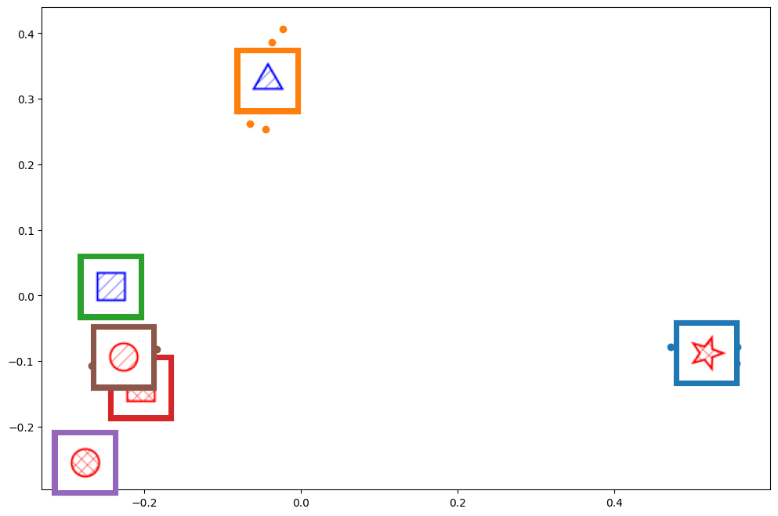
Sparse
https://www.youtube.com/watch?v=qW25mQagNRk

Slide 27
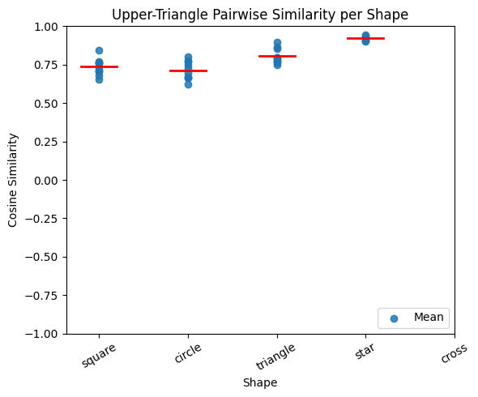
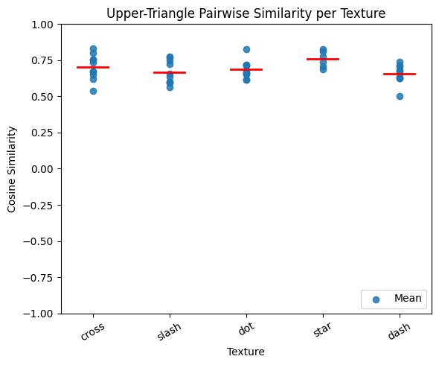
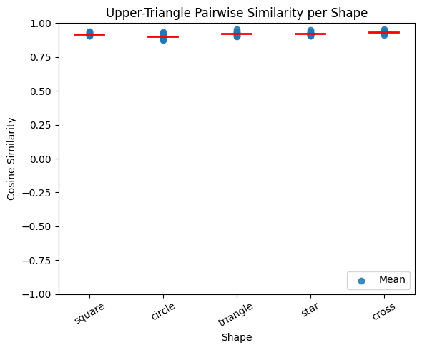
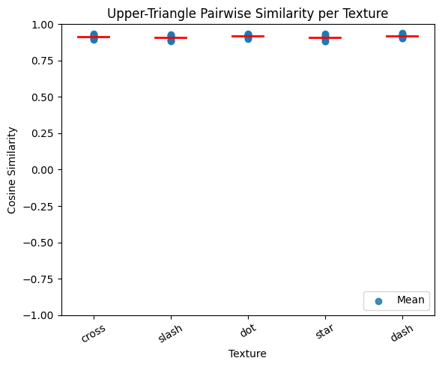
Law 1
within-dimension similarity is reversely correlated with between-dimension similarity
attention: suppress the irrelevant dimensions, preserve the relevant dimensions
Simple similarity of embedding
Social Identity priority
word
Shape > Similarity > color; get the ordering
color
Important
Used (attention)
Low similarity (distinguish)
Dynamic importance overwrite
No variance
No information
shape
red
green
square
star
Law 2
Different dimensions have different scales
Some dimensions like color is more dense than other dimensions like shape or texture
Normalize → Law 1

Slide 28
Texture
Shape-dominant
Shape

Slide 29
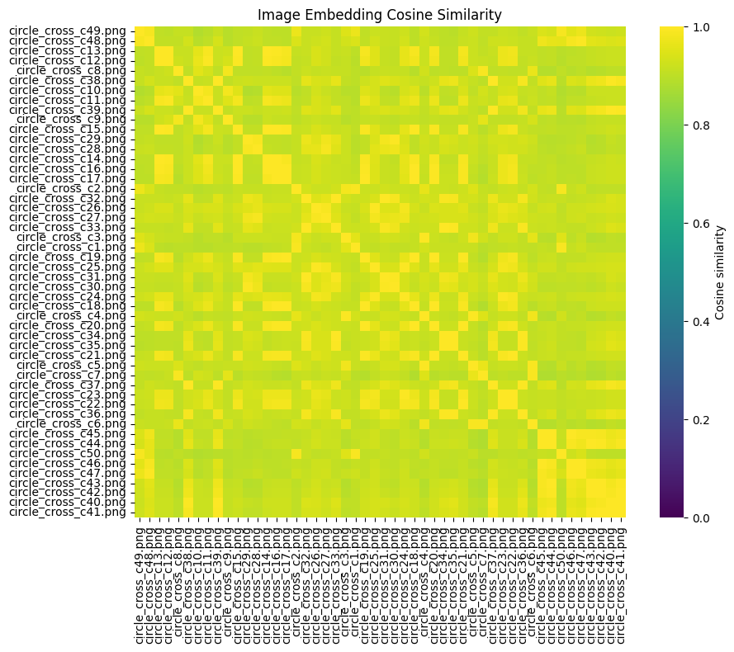
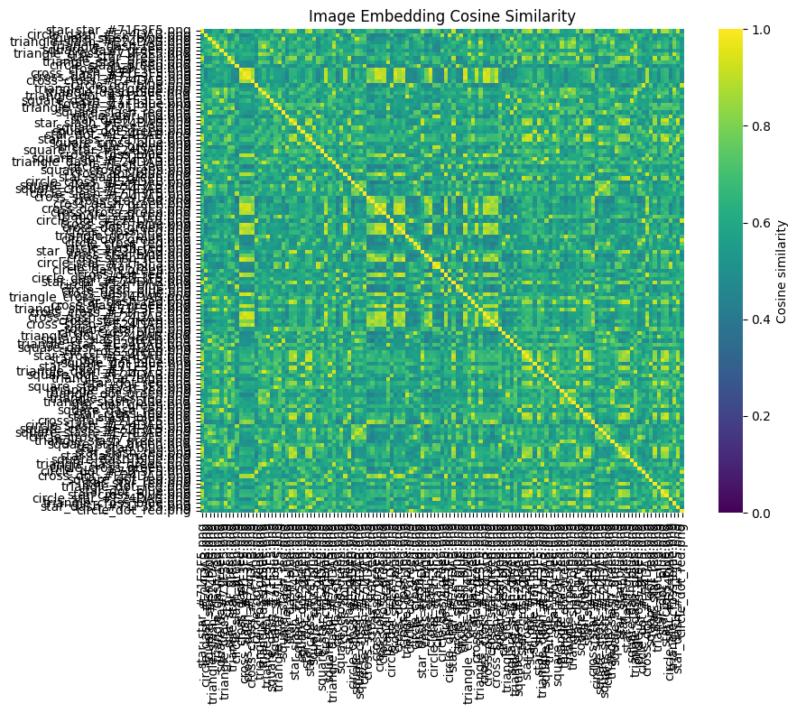
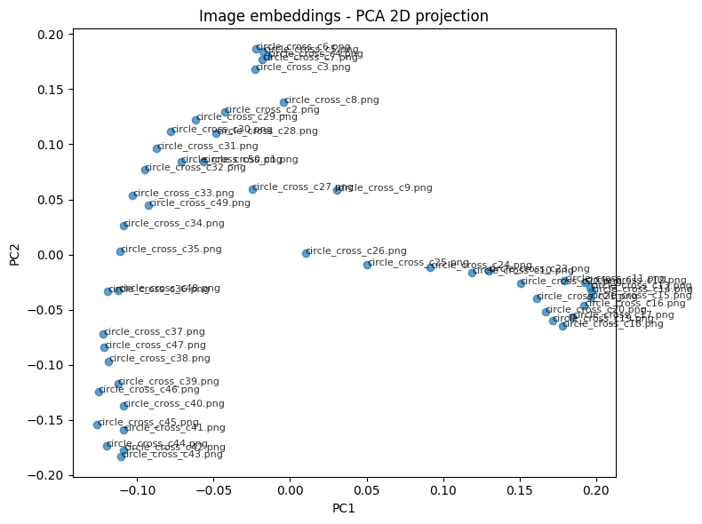
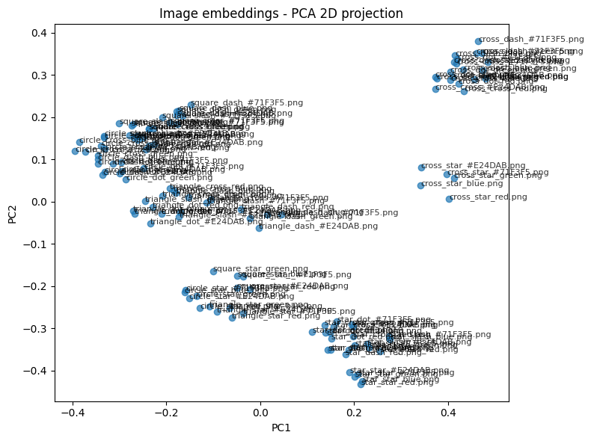

Slide 30
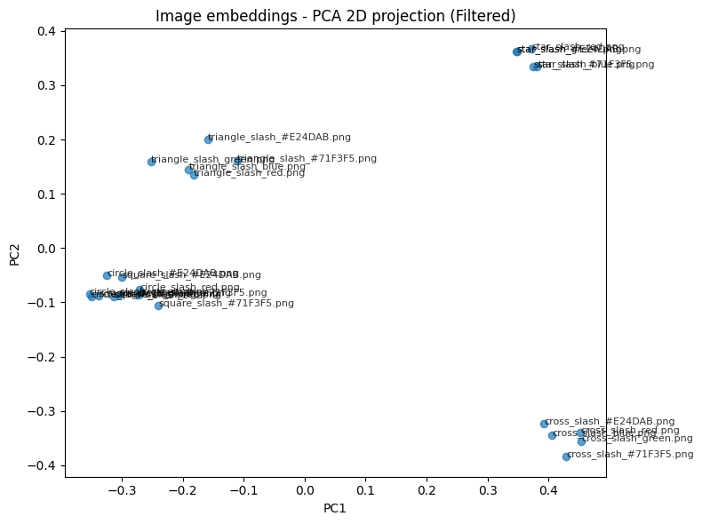
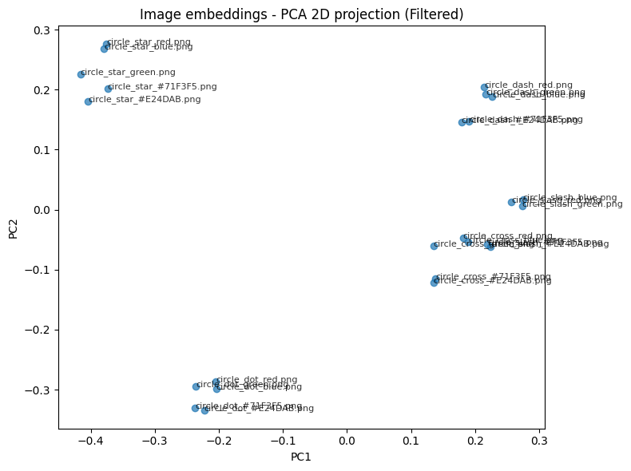
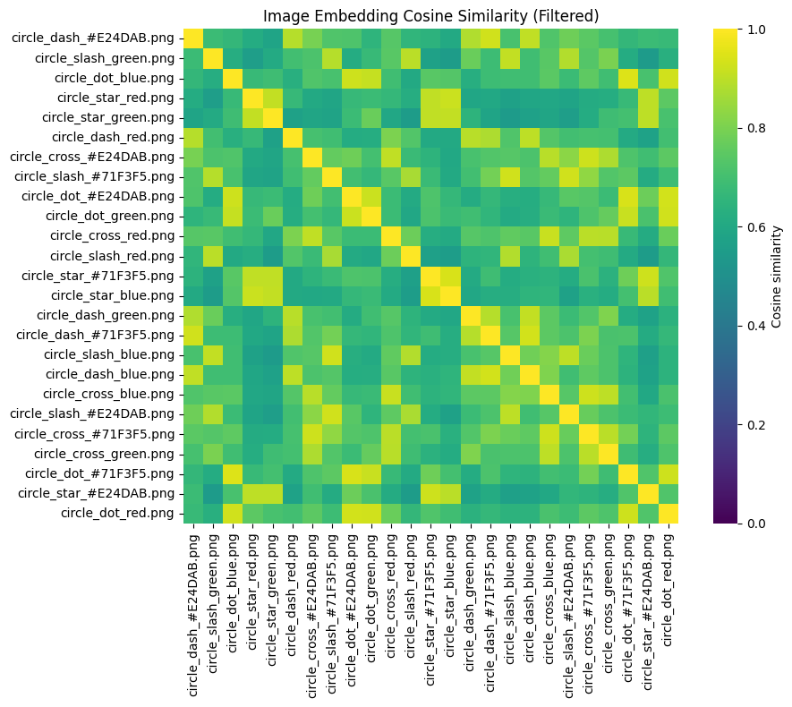
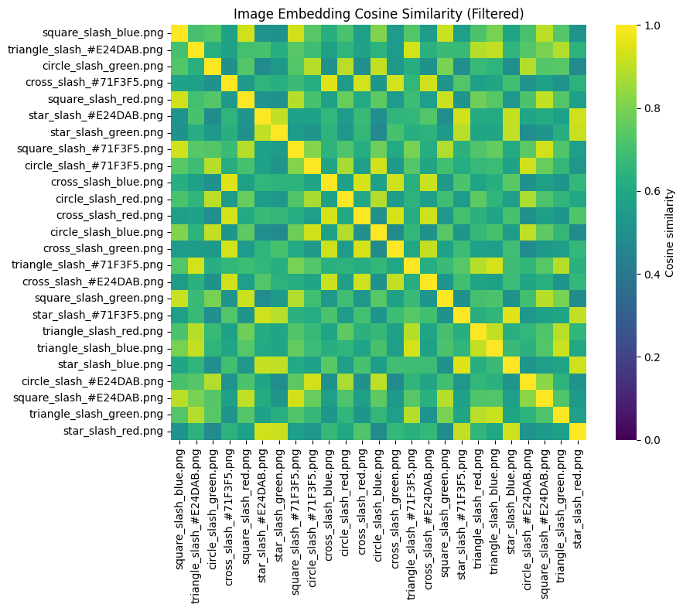




Semantic representation distortion
Shape shrinks other dimensions; weird shape shrink more
Shape > texture
Rare > common
2
Common shape
3
Common texture
1
Rare shape
2
Weird texture
For a multidimensional stimulus, if weird in one dimension, then other dimensions get down-weighted

Slide 31
After controlling shape and texture
Variance is zero
Color can’t contribute to explain the variance in embedding
Embeddings (representations) don’t distinguish colors
In general, embedding cares shape more than texture
But there are exceptions: star texture is considered more than square shape
Occasional (stimuli-based) priority
If one feature is really weird in its dimension
The distance on that dimension is huge
After normalization, other dimensions get weighted down
Resulting in the dominance of that dimension in that case.
“Snake shape one cluster”; Law 1: larger within-dimension feature distance leads to dimension dominance

Slide 32



Cautious about interpretation generalization: don’t just about clustering/PCA and model
Representativenss
Weirdness
Perceptual similarity
Or just because dense, all similar

Slide 33
TODO
Talk
Alaska representation, color
Lookup
Classification paper
Potential
LLM embedding node
network
Pipeline
Select dimensions and feature (cognitive map | Erie Boorman; Classification | Tom)
For each dimension, rank of weirdness
normalize?
Competing between dimensions
Calculate distance
SPoSE
Operationalize IV (predictors, driving factors)
Novelty: word frequency; generate AI summary
Ambiguity: classification entropy; free-association entropy

Slide 34
Experiment
Shape only
Shape + texture

Slide 35
Experiment
Shape + texture

Slide 36
Experiment
With weird shapes
Without weird shape

Slide 37

Differentiate who, but only boy from other
Differentiate where, all (park, shopping-mall, zoo)
Park, zoo, mall
Boy
Grandma, man

Slide 38







Slide 39



Natural association between who and where

Slide 40









Slide 41
Largest sparsity among who
Common where

Slide 42


Typical → suppress others
Prototype, weird

Slide 43





Equally poor
color
texture
shape
blue
star
cross
weird
slash
circle
red
common

Slide 44






Not entirely rarity
But rarity could be one (bruce, boy)
Who
Where
Equally strong
bruce
Desert
woman
mall
boy
airport

Slide 45


Bruce>woman= Man>boy>grandma
Zoo>airport>mall=park=desert>none
Semantic:
Woman-man; woman-grandma
Semantic:
More-airport
object recognition?
With object, higher score, competitive (like zoo with giraffe)

Slide 46


Zoo>airport>mall=park=desert>none
Semantic:
More-airport
None-other
object recognition?
With object, higher score, competitive (like zoo with giraffe)

Slide 47
Bruce>woman= Man>boy>grandma
High or low similarity to other features (target dim)
Leads to stronger other dim similarity
No people, no masking
Semantic:
Woman-man; woman-grandma
None-other

Slide 48
Simple mix?
Or interaction

Slide 49


Slide 50
Dimension-based not enough → stimuli feature variability
Feature /norm -based not enough → hard to estimate, isolated
Norm competing → different dimensions have features varying in norms; dimension with high-norm feature gets attended
Biologically, it’s impossible to have representation for all features in each dimension (curse of dimensionality)
It is more plausible that our brain act by dimension
But there is variance in each dimension, so the current solution is not accurate. thus we should introduce norm
Across dimension competing of feature norm
A brand-new perspective
This is not denying the importance of dimension, but a potentially better way to obtain more precise dimensions

Slide 51
Observation
”Salient feature” amplify its dimension while suppressing other dimensions in similarity pattern
cross
circle
One component feature dominants, others suppressed
Components across multiple dimensions ,competition among features can be regarded as competition of dimensions

Slide 52

Rationale & Assumption
What determines the attention?
Given our cognitive and experiential bottleneck:
We could only:
Maximally represent finite important dimensions (RE category recognition, Gallant)
For a specific stimulus, selectively attend to a subset of dimensions at a time (RE dimension identification, Isik)
Time
Finite, dynamic, adaptive

Slide 53




Feature competing hypothesis
Representation of Multi-dimensional Semantic Information
Decomposition
Dimension - feature
Semantic salience of feature
norm in semantic space
Stimuli
competing
Brain activity
feature
Shape
Texture
Color
$$L\left( \right)=0.4$$
$$L\left( \right)=0.6$$
$$L\left( \right)=0.3$$
> >
dimension
Texture > Shape > Color
Texture dominates in this stimuli
Texture-related
area saliently activated
feature
Shape
Texture
Color
$$L\left( \right)=0.9$$
$$L\left( \right)=0.6$$
$$L\left( \right)=0.3$$
> >
dimension
Shape > Texture = Color
Shape dominates in this stimuli
Shape-related
area saliently activated
Multi-dimensional
Importance In general
PCA results
Continuous, comparable
Finite activity, attention
algebra
This is not denying the importance of dimension, but a potentially better way to obtain more precise dimensions

Slide 54
Information correspondence: how dimensions and feature are represented
Each stimuli can have only one feature in each dimension
Dimension
Feature
Circle
Shape
Square
Base vector
Star
Pattern of base vector
(Probably multiple) nodes serve for dimension, not feature
Statistically identifiable,
No direct semantic importance
not identifiable
Has semantic importance
Dimension would benefit from considering feature semantic importance
The real dimension division is much more complex than this (weight, not arbitrary)

Slide 55

Bottom-up: clustering of nodes
Top-down: find interpretable features, correlate embeddings
Golden state bridge paper, auto-encoder
Shape
Texture
Color
Example:
Embedding
Sum of base vectors
Competing norms
L(Circle) > L(Dot) > L(Red)
Shape Dominant
appear to be “by shape”
In similarity-based tasks
Others suppressed
like
PCA/clustering or free-association
stimuli vector (sum vector)
leans to high-norm feature
Color Shape Texture
Interpretable features
similarity is modulated by norm
For efficiency
High-level, orthogonal base dimensions
But not for feature
Some dimensions have high norm (more important) in general → general preference
But in-general-low-norm (less important) dimension could have high-norm feature → attention shift
Traditionally, different dimensions are categorical thus not comparable
By identifying the semantic importance (measured by embedding norm), they become comparable
A pattern in base vector corresponds to a specifical feature
Base vector in general corresponds to dimension
The former is hard to perform statistical test, hard to detect
The second one is feasible, yet modulated by the first
For naturalistic viewing: key is to identify semantic importance of each feature

Slide 56
Think about implication
A pattern in base vector corresponds to a specifical feature
Base vector in general corresponds to dimension
The former is hard to perform statistical test, hard to detect
The second one is feasible, yet modulated by the first

Slide 57
Formal proof
Embedding algebra
Cosine similarity bias
Norm as main factor
Understand norm: novelty, prototypical

Slide 58
Observation
”Salient feature” amplify its dimension while suppressing other dimensions in similarity pattern
cross
circle

Slide 59

If one dimension has a salient feature, then other dimensions get suppressed, similarity increase, shrink
During similarity calculation
Considering the distance between combined multi-dimensional stimuli
Shared feature on other dimension suppresses distance in this dimension
$$cos\left(who+zoo, who+mall\right)>cos⁡(zoo, mall)$$
The longer norm the shared vector has, the larger shrink effect becomes:
$$cos\left({who}_{long}+zoo, {who}_{long}+mall\right)>cos\left({who}_{short}+zoo, {who}_{short}+mall\right)$$
For instance:
$$L\left(woman\right)>L(boy)$$
$$cos\left(woman+zoo, woman+mall\right)>cos\left(boy+zoo, boy+mall\right)$$
A at zoo
Who = A
A at mall
Where = zoo
Where = mall
woman at zoo
Who = woman
boy at zoo
woman at mall
Who = boy
Where = zoo
Where = zoo
boy at mall
Where = mall
Where = mall
Notes:
Its own norm won’t matter in calculating cosine similarity, as cosine concerns angle, not value
But its components’ relative norm should matter, as it might bias the total vector

Slide 60
High-norm feature shared in one dimension increases similarity among stimuli varying in other dimensions
Similarity between stimuli
Expected
Norm of shared shape feature
Similarity between stimuli
Actual
Norm of shared shape feature
https://arxiv.org/pdf/1901.09813
Notes:
Varying on other dimensions
https://www.technologyreview.com/2015/09/17/166211/king-man-woman-queen-the-marvelous-mathematics-of-computational-linguistics/
https://www.reddit.com/r/computerscience/comments/1f4sg8b/king_man_woman_queen/
https://arxiv.org/pdf/1509.01692
https://informatics.ed.ac.uk/news-events/news/news-archive/king-man-woman-queen-the-hidden-algebraic-struct
https://community.openai.com/t/some-findings-on-the-meaning-of-embedding-discuss-with-the-example-of-woman-man-queen-king-female/171633
https://mikexcohen.substack.com/p/king-man-woman-queen-is-fake-news
https://www.51cto.com/aigc/6115.html

Slide 61
Impact on clustering
Flexible, adaptive
Traditional clustering → nothing
Notes:
Varying on other dimensions
https://www.technologyreview.com/2015/09/17/166211/king-man-woman-queen-the-marvelous-mathematics-of-computational-linguistics/
https://www.reddit.com/r/computerscience/comments/1f4sg8b/king_man_woman_queen/
https://arxiv.org/pdf/1509.01692
https://informatics.ed.ac.uk/news-events/news/news-archive/king-man-woman-queen-the-hidden-algebraic-struct
https://community.openai.com/t/some-findings-on-the-meaning-of-embedding-discuss-with-the-example-of-woman-man-queen-king-female/171633
https://mikexcohen.substack.com/p/king-man-woman-queen-is-fake-news
https://www.51cto.com/aigc/6115.html

Slide 62

Notes:
Combined stimuli (word), decomposition into shared feature and difference

Slide 63

instances
context
Context-dependent instances
sterotype
Man/woman + parent = father/mother

Slide 64

Queen
king
Woman
man
Queen-king = woman - man
Embedding algebra is not suitable when the context is too dominant
Algebra stands for image, but not for text
In image, norm impacts; high-norm, low between distance
In text, no norm exists; high distance, same between distance

Slide 65

special
Longer norm
prototype
Longer norm, higher similarity, larger shrink

Slide 66

Test: contrast of gender in different occupations
Predct: long-norm occupations have less discrimination between genders
However, seems to be reverse, and small
Why variance?
Nearly the same (1e-6)
Due to word embedding: all normalized, in a sphere. Thus small; norm = 1
Notes:
CLIP 设计上 强制所有 embedding 投射到 unit hypersphere
你看到的是 normalized embedding
“norm 差异”不是 CLIP 中用来编码语义的手段
CLIP 用 方向变化 而不是 大小变化 来表达意义

Slide 67

Reverse 仍然存在
是否机制有问题？不该剪还是？
随机匹配(都是一类 不会低)
反转顺序(不应，因为你用的是均值)
3. 不减基线?(差别不大，rank应该一样）
标准就是，一一对应， factual 不是刻板印象，两个词都较常见同时又不会有强烈歧义
有没有别的 稍微常见一点
类似性别，年龄，首都，复数
有一定数量
部分或许可以用来了解为什么norm长这样 (state, country tension 复数)

Slide 68
Sum norm goes up
Similarity goes down,
difference norm goes down?
Difference should be the same?
woman at zoo
Who = woman
boy at zoo
woman at mall
Who = boy
Where = zoo
Where = zoo
boy at mall
Where = mall
Where = mall

Slide 69

组合类别的很少 为什么

Slide 70

Boundary 很清晰 人和场景之间
不同domain的variance
有一些更加清晰
有一些没什么区别(颜色)

Slide 71




Positive cos
cos result is gone
woman at zoo
Who = woman
woman at mall
Where = zoo
boy at zoo
Who = boy
Where = mall
Where = zoo
boy at mall
woman at zoo
Diff result reverses
Where = mall
Who = woman
woman at mall
Negative cos
Where = zoo
Where = mall
如果是一个维度dominant 那差的向量应该大，而不是小；而夹角的效应应该消失
distance小 夹角小只能是预想情况
Notes:
修改analyze_word_pairs得到一个新的函数 这个函数在计算y的cosine similarity时首先把词对两个vector标准化 再计算cos 但是不影响x(x仍然使用原始) 这个图里顺 另外，绘制词对normlized之后的差值和X的关联 一样的图 只不过替换Y 这个图里顺便标记

Slide 72






Comparing anchor baseline
Based on the theory before, how could the angle be smaller than anchor?
Not very accurate
Multiple meanings
Whether to normalize before calculating metrics
Notes:
In general, we observed the pattern (most above baseline); but with a few exceptions
Base dimension is defined, not necessarily the “foundation”
We assume the new dimension is orthogonal to base; but they could be correlated or opposite, which leads to reverse
Specific reasons see above

Slide 73




Based on the theory before, how could the angle be smaller than anchor?
Male, female could describe animal
Whether to normalize before calculating metrics
Normalization effect should be?
Why some falls behind
Why different dimensions have difference

Slide 74


找到最典型的family
Validate with free-association task
Find the most prototypical
Try different pair as anchor
Which one always has the lowest differences
考虑这个dimensio上的所有词对
不断变换anchor, 找到最prototypical的
始终最小距离的那个
排序反映了prototypical, semantic importance
用在人类

Slide 75
Projection on that dimension
Policeman on man
Fit a computational model for that
permutation
Not what we observed
Why length goes down
Normalization won’t impact similarity, but changes difference
Normalization increases the number of right in diff
shall diff stands?

Slide 76









In general if conditions stand
Shared Norm increases similarity, cluster
Shiny
Conditions
$$d=∥a_{2}−b_{2}∥=∥{(a}_{1}+ c)−(b_{1}+c)∥=∥a_{1}−b_{1}∥$$
Expalin, not necessary
$$If ______$$
then $∥a_{2}∥=∥{(a}_{1}+ c)∥>∥a_{1}∥and∥b_{2}∥=∥{(b}_{1}+ c)∥>∥b_{1}∥$
a2
then
If c orthogonal cos(a1,c) >=0; cos(b1,c) >=0
$$∥a_{2}∥=√∥a_{1}∥^{2}+∥c∥^{2}>∥a_{1}∥$$
$$β1≻β2>0$$
If cos1>0, $β1<\frac{π}{2}$
$$0<β1<β2<\frac{π}{2}$$
Cos 2 > cos 1
Larger c, smaller $β$, larger cos
C2’>c1’
$$0<β1<β2<β2′<\frac{π}{2}$$
Cos2< cos2’
c
d
b2
a1
d
$$β_{2}′$$
b1
b2’
b2’
$$β_{2}$$
Conclusion
If cos < pi/2 between each two
Adding a shared feature
Shrink the angle
Increase the cos
a2
b2
$$β_{1}$$
a1
b1
If $β1<π/2$
d
If $a2<a1, b2<b1⇒β2≻β1, cos2<cos1$
If $a2>a1, b2>b1⇒β2<β1, cos2>cos1$
C in relation to common angle
We use cosine similarity as distance in non-Euclidean space
We could skip norm of difference, just describe the relationship between norm and cos, and a potential explanation
Under Conditions

Slide 77
How about difference, why
Don’t normalize, same length
Why different
$$β_{2}′$$
b2’
b2’
$$β_{2}$$
Normalize will impact diff norm
Larger c, longer 2, smaller angle, smaller diff ➔ negative relationship
a2
b2
$$β_{1}$$
a1
b1
d
Smaller angle

Slide 78
We usually informed: normalize before calculating
Why model treat images as more similar?
But the raw norm length might tell us something:
Norm length is proportional to encoded information amount
Longer norm, encode more information, more dimension
Longer shared norm leads to higher similarity between embeddings
With- text or image or even cross modality
A general principle
Formally: stand under some conditions (<90, cos>0); indeed, all of them are above 0

Slide 79
Brain part of model
Several independent dimensions

Slide 80
More orthogonal dimensions, longer norm
Stronger
Additive
Information group, Noah, Frank ..
Model in sensitive to tighly things like edge (out of human perception, but detected)
GenAI: informative pieces

Slide 82
Why would some vectors have longer norms
Centered in more dimension (more associations)
Prototypical, weird
Think about training process
More orthogonal dimensions, longer norm
Higher similarity
array([[1.0391269], [0.9206795], [1.0979444], [0.9943374], [1.0264026], [0.9859952], [1.0063548], [0.927344 ]], dtype=float32)
array([[0.61045146], [0.72247684], [0.5849232 ], [0.57241035], [0.58057684], [0.5805612 ], [0.58366275], [0.66267824]], dtype=float32)
Specific has longer norm or broad has longer norm

Slide 83






Cosine similarity
Raw
Different noise
(even normalized embedding)
Normalized
similarity
Same pattern
Notes:
Similar (relative) patterns in within-text, within-image, image-text heatmaps;
yet the image has in general higher similarities; text is the largest contrast; image-text is weak, but pattern StopAsyncIteration
Could this be explained by the principle? image as text + modality, thus becomes more similar.
Inherently images have more dimensions to be similar, thus the norm of shared dimension increases, leading to higher similarities.

Slide 84
One long, one short
a2
c
b2
b1

Slide 85
All features

Slide 86


Images have higher norm, but don’t have higher similarities as predicted, why
One reason is that the description don’t match image content, description like “man_park” is simplified

Slide 87

Increase the granuality of decription, norm increase or decrease?
More detailed description, lower norm
不加a picture of, 比较接近，加了之后拉开差距；但是order是一样的

Slide 88
Boundary factors, testing
Increase the granuality of decription, norm increase or decrease?
Increase the granuality of decription, norm decreases.
Broad feature is a combination of multiple semantic information
语义的
组合的 (easier to manipulate information proportion)
Information could be a
图片
文字
Interestingly, when adding prefix
Relationship becomes more clear
房间里加东西
图片遮蔽像素
Different domains seem to have different
Car is clear even without prefix

Slide 89
从购物网站获取keyword list
Full list, 每一个都独立
At least, norm could be explained by informativeness
Full list of adj, 定语
每一次移除一个(多个) 随机
看norm如何变化
图片，蒙版的思路
Different dimensions
Random pick feature
Number of dimensions
Feature value
Feature的组合
norm
word

Slide 90

Welcome exceptions
Understand unknowns
In general, more dimensions, more specific, lower norm
While some dimensions have higher contribution to informativeness than others
Controlling their own norm (how to quantify)
Use this to understand image processing
Notes:
plt.figure(figsize=(10, 6))
# Plot scatter points for each simulation
for level in range(1, len(description) + 1):
# Get indices for this level
level_mask = np.array(level_indices) == level
level_norms = text_norms[level_mask]
# Add small jitter for visibility
x_positions = np.ones(len(level_norms)) * level + np.random.normal(0, 0.05, len(level_norms))
plt.scatter(x_positions, level_norms, alpha=0.6, s=50)
# Plot mean line
level_means = [text_norms[np.array(level_indices) == level].mean()
for level in range(1, len(description) + 1)]
plt.plot(range(1, len(description) + 1), level_means, 'r-', linewidth=2, label='Mean')
plt.xlabel('Number of Descriptions (Level)', fontsize=12)
plt.ylabel('Embedding Norm', fontsize=12)
plt.title(f'{description} (n_sim={n_sim_per_L})', fontsize=14)
plt.legend()
plt.grid(True, alpha=0.3)
plt.tight_layout()
plt.show()

Slide 91


More component, shorter norm (reverse!!)
Each component is again a combination
recursive
Lowest norm → basic dimension | implication
Human do the same thing?
Exceptions
In the Dog case:
Small n_sim leads to error
Large n_sim, random, provides the right pattern

Slide 92







Non-linear; floor effect
How to explain within-level variance?
Norm of component? Order? maybe
Impossible, varying to much
each vector and relationship
Angle with target
“collective intelligence”
This is enough

Slide 93






First should be strongest right
Color is right, alpha, overlapping
Reverse?
Some dimensions have higher norm
Describing inanimate > animate
If orthogonal dimensions, average norm is predictive
Number is predictive
Object more orthogonal

Slide 94







两个类型 why
越多 效应越强
Shorter range
Positive
orthogonal
Larger, sample
Specific word

Slide 95
Converging in the end because there is nothing to choose from
Is there a ceiling?
Image is the same, just even more dimensions
feature
More feature, shorter norm
Higher similarity
Conditional probability
Conditioning on a lot of things, then nothing to change
Similarity principles

Slide 96
Simulation
pattern
Normalization of resulting
Angle lower,
Cos unsure
Length stay
same
Raw: random
Nomalized → cos
Longer,

Slide 97
Better way to come up with this
穷尽
符合标准
标准：
只有单词（不允许短语、不允许 hyphen、不允许重复词）
pair 内两个词是不同的单词
每一个 pair 都是同一类型的具体事物（都是动物 / 都是植物 / 都是物品…）
不同 pair之间类型可以不同
但 pair 内部体现某一个明确维度的对立（软–硬 / 工具者–工具 / 固体–液体）
必须常见、无歧义、无刻板印象、可用于 embedding
形容词，对立

Slide 98
Image preserves the raw embeddings, not normalized
Therefore norm is important

Slide 99
Generative AI也这样吗
复杂组合， Low norm 更不容易组合出来
不容易生成
在一系列模型和任务上检验; norm is ignored
Universal principle of embedding

Slide 100
More model
Language model
Transformer-based

Slide 101


One minimalist dining elegant polished wooden sturdy round clean table light-brown
Dining elegant polished clean wooden round sturdy minimalist light-brown
Bad performance
High-correlation: clean
Low norm: light-brown

Slide 102




Red

Slide 103

Straight-backed
Light-brown

Slide 104




Weight: Lower correlation, larger impact (moderate, depending on specific)
Direction: Low norm, low; high norm, high
Component vectors
regression
Slope; shrink; decreasing
In a contextual format
Become accurate “black”

Slide 105



conical surface fixed in origin
Embeddings are all positive
https://www.reddit.com/r/LanguageTechnology/comments/15egrkb/cosine_similarity_in_sentence_transformers_how_to/
Antonyms are not “opposite”, they are quite similar for many dimensions
Think of difference?
https://vaibhavgarg1982.medium.com/why-are-cosine-similarities-of-text-embeddings-almost-always-positive-6bd31eaee4d5
https://datascience.stackexchange.com/questions/101862/cosine-similarity-between-sentence-embeddings-is-always-positive
Notes:
More shared features, higher similarity
Beyond the target dimension

Slide 106
Assumption:
Algebra; orthogonal
Norm 2 > norm 1
contextual

Slide 107




“boy in yard” more similar to “boy outdoor” or “girl in yard”
Similarity judgement in multi-dimensional environment
grandma
woman
girl
Girl is more similar to grandma, or boy
$$α$$
A,b相等
Larger area,
Considering orthogonal dimensions gender and age
If L(gender) > L(age)
$$α>β$$
cos(girl, grandma)>cos(girl, boy)
Stronger shared dimension, higher similarity
old
young
$$β$$
Dimension is important, rely on it
Importance is operationalized as norm length
If one dimension has more associated meaning
It has longer norm
man
boy
Containing low norm contrasting, smaller

Slide 108



Similarity judgement in multi-dimensional environment
Grandpa vs. boy grandma vs. girl
Which pair is more similar?
grandma
woman
girl
Conclusion:
The pair with longer shared vector
g1
Two orthogonal dimensions: gender, age
If L(man)<L(woman)
No matter the relationship between old-young
$$π>β>α>0$$
$$\cos\left(β\right)<cos⁡(α)$$
Prove:
$$α$$
a2
a1
old
young
$$β$$
g2
grandpa
boy
man

Slide 109
Human classification or selective attention (dimension reduction), stereotype
Traditional view: one dimension is salient, the others are ignored
feature-wise, not dimension-wise)
gender is salient → female is salient
2. Predict this trend, measure salient: embedding norm
Average, distance to baseline
Find prototype
Gender
hf
bf
Female
wf
af
If female is more semantically salient (longer norm), then:
Female tend to be clustered together, regardless of race
Race in male get distinguished
Hispanic
Black
hm
Race
bm
White
Asian
If one dimension in general has longer norm features
Then it usually dominants
But exception exists
wm
Male
am
Model-human inspire each other
Notes:
Todorov

Slide 110


LLMs focus on dimension containing long-embedding feature during classification or clustering
Case 1: Classification (free-association) task
Where
Prompt: “List the most relevant word”
Who
boy
GPT
“boy”
desert
Why is “where” dimension ignored?
“boy”
Assume dimensions are orthogonal: Who, Where, Modality
$$\vec{target}=\vec{image}+\vec{boy}+\vec{desert} \\ \vec{“boy”}=\vec{text}+\vec{boy} \\ \vec{“desert”}=\vec{text}+\vec{desert}$$
$$If, L\left(\vec{boy}\right)>L(\vec{desert})$$
$$then, cos\left(\vec{target},\vec{“boy”}\right)>\cos\left(\vec{target}, \vec{“desert”}\right)$$
$$⇒output:“boy”$$
“desert”
Notes:
Projection paper NHB

Slide 111



LLMs focus on dimension containing long-embedding feature during classification or clustering
Case 2: Clustering task
Where
Clustering of CLIP embeddings
Who
boy
desert
Why is “where” dimension ignored?
Assume dimensions are orthogonal: Who, Where, Modality
$$\vec{ boy_park}=\vec{image}+\vec{boy}+\vec{park} \\ \vec{boy_desert}=\vec{image}+\vec{boy}+\vec{desert} \\ \vec{woman_desert}=\vec{image}+\vec{woman}+\vec{desert}$$
$$If, L\left(\vec{boy}\right)>L(\vec{desert})$$
$$then, cos\left(\vec{ boy_park},\vec{ boy_desert}\right)>\cos\left(\vec{ boy_desert},\vec{ woman_desert}\right)$$
$⇒$boy_desert is closer to boy_park than woman_desert
Notes:
Projection paper NHB

Slide 112
No slope?
Pure dimension effect
difference

Slide 113
In embedding, shared dimensions too much, already shaped
Positive

Slide 114
Experiment | CS
Clean, instant
Mechanism
Model, knowledge representation, embedding
Creative design and question
application

